Slide 1

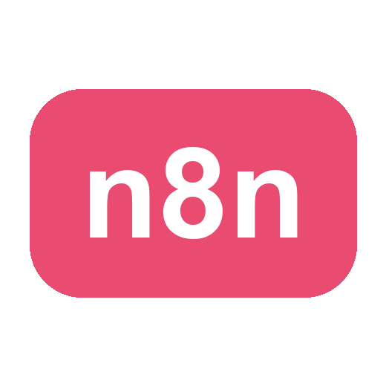
COURSE SLIDES · NON-WSQ
Automate Business Processes with Agentic AI Workflows
Course Code: C209
Non-WSQ commercial short course
Conducted by Tertiary Infotech Academy Pte Ltd · UEN 201200696W
Version v2.5 · 17 October 2026
© 2026 Tertiary Infotech Academy Pte Ltd. All rights reserved. · www.tertiarycourses.com.sg

Slide 2
COURSE ADMINISTRATION
Welcome & Housekeeping
Automate Business Processes with Agentic AI Workflows · C209
© 2026 Tertiary Infotech Academy Pte Ltd
2

Slide 3
YOUR TRAINER · GENERAL
About the Trainer
NAME
____________________________________________
?
TITLE / DESIGNATION
____________________________________________
QUALIFICATIONS
____________________________________________
Your Trainer
AREAS OF EXPERTISE
____________________________________________
General Trainer template —
to be completed by the trainer
TRAINING & INDUSTRY EXPERIENCE
____________________________________________
CONTACT
____________________________________________
Automate Business Processes with Agentic AI Workflows · C209
© 2026 Tertiary Infotech Academy Pte Ltd
3

Slide 4
YOUR TRAINER
About the Trainer
ROLE
Principal Trainer, Tertiary Infotech Academy Pte. Ltd.
AA
QUALIFICATIONS
PhD — specialises in AI, automation and software engineering.
Dr. Alfred Ang
DELIVERS
Courses on agentic AI, workflow automation (n8n) and app development.
Principal Trainer
Tertiary Infotech Academy Pte. Ltd.
FOUNDER
Founder and lead instructor at Tertiary Infotech / Tertiary Courses.
Automate Business Processes with Agentic AI Workflows · C209
© 2026 Tertiary Infotech Academy Pte Ltd
4

Slide 5
ICE-BREAKER
Let's Know Each Other
Who you are
Your name, your organisation and your role.
Your starting point
Your experience with automation or AI tools — including none at all.
1
2
Your pain point
One business process in your work you would most like to automate.
Your goal
What you want to be able to build by the end of this course.
3
4
Automate Business Processes with Agentic AI Workflows · C209
© 2026 Tertiary Infotech Academy Pte Ltd
5

Slide 6
HOUSEKEEPING
Ground Rules
Set your mobile phone to silent mode.
Participate actively — no question is too small.
1
2
Mutual respect: agree to disagree.
One conversation at a time.
3
4
Be punctual; return from breaks on time.
Full attendance — attend both days to get the most from the course.
5
6
Automate Business Processes with Agentic AI Workflows · C209
© 2026 Tertiary Infotech Academy Pte Ltd
6

Slide 7

COURSE PORTAL
Login to LMS and Download Course Material
Log in at lms-tms.tertiaryinfotech.com with your registered email and the OTP sent to your inbox, then open this course to download the slides and Learner Guide.
Automate Business Processes with Agentic AI Workflows · C209
© 2026 Tertiary Infotech Academy Pte Ltd
7

Slide 8
COURSE PORTAL · STEPS
Download Course Material
1
2
3
4
5
▶
▶
▶
▶
Go to lms-tms.tertiaryinfotech.com
Enter your registered email and click Send OTP
Key in the one-time password from your inbox
Open this course and download the slides + Learner Guide
Keep them open — you will refer to them throughout the labs
Automate Business Processes with Agentic AI Workflows · C209
© 2026 Tertiary Infotech Academy Pte Ltd
8

Slide 9
GET THE FLOWS
Get the Course Workflows
Every lab ships a workflow
A ready-made n8n workflow (.json) sits in each lab's folder under labs/.
Import it
In n8n: Workflows → Add workflow → the '...' menu → Import from File → pick the lab .json.
1
2
Re-select your credentials
After importing, re-select YOUR OWN credentials on every node showing a warning.
Nothing of yours is shared
Imported workflows reference credential NAMES, not secrets — no key travels in the file.
3
4
Automate Business Processes with Agentic AI Workflows · C209
© 2026 Tertiary Infotech Academy Pte Ltd
9

Slide 10
SCHEDULE
Lesson Plan — 2 Days, 7.5 hours/day
DAY 1 — n8n, AI Agents and Agentic Chatbots
DAY 2 — Human in the Loop and RAG
• Topic 1: Why agentic AI, and why workflow first
• n8n fundamentals → Lab 1 — trigger, action and QR flyer
• AI agent building blocks and webhooks
• Lab 2 — Webhook and AI Agent
• Timing: 9:30 am – 5:30 pm
• Topic 2: Agentic chatbot and human in the loop
• Lab 3 — Chatbot webhook
• Lab 4 — Human in the loop
• Topic 3: RAG
• Lab 5 — RAG customer care chatbot
• Course recap and next steps
• Timing: 9:30 am – 5:30 pm
Each day is 7.5 instructional hours, 9:30 am – 5:30 pm, with a 30-minute lunch break excluded from instructional time
Automate Business Processes with Agentic AI Workflows · C209
© 2026 Tertiary Infotech Academy Pte Ltd
10

Slide 11
COURSE JOURNEY
Five Connected Labs
Each lab keeps the agent and changes one thing — the front door, the tools, the oversight, the knowledge.
LAB 1
form → email
LAB 2
webhook + agent + tools
LAB 3
chatbot + memory
LAB 4
human approval gate
LAB 5
RAG over documents
▶
▶
▶
▶
1
The front door changes
2
The agent gains abilities
3
The oversight grows
Form Trigger in Lab 1 becomes a Webhook in Labs 2–5 — the workflow behind it barely moves.
Lab 2 adds tools, Lab 3 adds memory, Lab 5 adds retrieval over your own documents.
Lab 4 stops the workflow dead until a licensed person approves what the agent drafted.
By Lab 5 you have built the whole pattern: a front door, an agent, its tools, its guardrails and its knowledge.
Automate Business Processes with Agentic AI Workflows · C209
© 2026 Tertiary Infotech Academy Pte Ltd
11

Slide 12
01
TOPIC 01
Overview of n8n and AI Agents
Why agentic AI · Workflow first · Triggers & actions · LLM agents · Webhooks
Applied in Lab 1, Lab 2
Automate Business Processes with Agentic AI Workflows · C209
© 2026 Tertiary Infotech Academy Pte Ltd
12

Slide 13
TOPIC 1 · A BRIEF HISTORY OF AI
A Brief History of AI, 2023–2026
Each year moved the skill that matters — from the words you type to the system you build.
Prompt Engineering
2023
Context Engineering
2024
Harness Engineering
2025
AI Agents
2026
▶
▶
▶
Wording the prompt
Curating the context
Building the harness
Agents at work
ChatGPT goes mainstream. Results depend on how well you word the prompt.
Models call tools and MCP launches. Results depend on the documents, data and tools you supply.
Claude Code and Codex: systems that plan, act and check their own work in a loop.
Always-on agents work 24/7 — OpenClaw, Hermes Agent and agent teams take on whole jobs.
From wording one prompt → curating context → engineering the harness → AI agents that work around the clock.
Automate Business Processes with Agentic AI Workflows · C209
© 2026 Tertiary Infotech Academy Pte Ltd
13

Slide 14
TOPIC 1 · GENERATIVE VS AGENTIC AI
Generative AI vs Agentic AI
The difference is not how clever the model is — it is whether it can act.
GENERATIVE AI — answers
AGENTIC AI — acts
• You ask; it writes one answer.
• No access to your systems, and no actions.
• Quality depends on what you paste into the prompt.
• Stops the moment the answer is produced.
• Example: draft me an email to this customer.
• Works toward a goal, not just one reply.
• Calls tools: looks up data, calls APIs, writes records.
• Holds a conversation with memory.
• Continues until the goal is met.
• Example: read the enquiry, check the CRM, reply and log it.
Generative AI produces content. Agentic AI decides and does — which is exactly why it needs governance.
Automate Business Processes with Agentic AI Workflows · C209
© 2026 Tertiary Infotech Academy Pte Ltd
14

Slide 15
TOPIC 1 · AGENTIC AI VS AI AGENTS
Agentic AI vs AI Agents
AI agents are a special type of agentic AI system — the kind that never switches off.
Agentic AI — the broad category
AI Agents — always-on agentic AI
• Any AI system that pursues a goal over many steps: plans, acts through tools, checks the result
• Usually started by a person or a trigger, and stops when the task is done
• Built as a workflow with AI steps, or around an LLM loop
• Includes the orchestration, guardrails and human approvals
• Examples: a Claude Code or Codex session; an n8n workflow with AI steps
• A special type of agentic AI system that exists 24/7
• Usually installed in the cloud, so it serves all the time — no laptop needs to be open
• Waits for events — messages, emails, webhooks, schedules — and acts on them around the clock
• Keeps its memory across conversations and days
• Examples: OpenClaw, Hermes Agent, an n8n agent on a cloud instance behind a webhook
Every AI agent is agentic AI, but not every agentic AI is an AI agent — an AI agent is always on, serving 24/7 from the cloud.
Automate Business Processes with Agentic AI Workflows · C209
© 2026 Tertiary Infotech Academy Pte Ltd
15

Slide 16
TOPIC 1 · WORKFLOW FIRST VS AGENT FIRST
Workflow First vs Agent First
Workflow first evolves rule-based (RPA) automation: the workflow owns the path, and its steps can be AI or AI agents, as in n8n.
Workflow First
Agent First
Who decides the path
The workflow — steps may be AI nodes or AI Agent nodes
The agent decides the steps and tools at run time
Behaviour
Deterministic — same input, same path, every time
Probabilistic — the path can change between runs
Efficiency
More effort to design every branch up front
Efficient — one instruction replaces many hand-built branches
Reliability & testing
Easy to test, debug and certify step by step
Harder to test; edge cases surface in production
Cost & speed
An LLM call only where needed — cheap and fast
An LLM call at every step — more tokens, more latency
Best for
Repeatable, regulated, high-volume processes
Open-ended tasks with unpredictable inputs
Source: n8n, In The Loop 2026 — opening keynote and product direction (youtube.com/watch?v=KQRe5UurLQ0)
Workflow first is more deterministic; agent first is more efficient. Companies make as much deterministic as they can.
Automate Business Processes with Agentic AI Workflows · C209
© 2026 Tertiary Infotech Academy Pte Ltd
16

Slide 17
TOPIC 1 · THE MODERN VIEW
The Trend: AI-Assisted Workflow Creation
AI-powered coding has flipped the trade-off — the agent's efficiency goes into BUILDING the workflow, not running it.
Describe
the process in plain English
n8n Assistant
or Claude Code / Codex drafts it
You review
test and approve it
Workflow runs
deterministic and logged
AI and agent nodes
where judgement is needed
▶
▶
▶
▶
1
Companies want determinism
2
AI coding made it cheap
3
The best of both
Reliability, compliance and audit push businesses to make as much of a process deterministic as possible.
n8n Assistant, Claude Code and Codex are AI agents themselves — they make designing, building and changing workflows fast and cheap.
An AI agent BUILDS the workflow; a deterministic workflow RUNS the process, with AI and AI Agent nodes where judgement is needed.
The trend: AI-assisted workflow creation — the AI builds the workflow, and the workflow runs the business process.
Automate Business Processes with Agentic AI Workflows · C209
© 2026 Tertiary Infotech Academy Pte Ltd
17

Slide 18
TOPIC 1 · COMPLEXITY VS CUSTOMISATION
Where AI Agent Platforms Sit
Three tiers — and AI now helps build at every one of them. This course teaches the middle one.
1
No-code
2
Low-code · n8n
3
Full-code
HOW YOU BUILD
Drag and drop in a fully visual builder.
CUSTOMISATION
Lowest. Fastest route to a working agent, least control over the internals.
HOW YOU BUILD
AI-assisted: n8n Assistant, Claude Code or Codex drafts the workflow on a visual canvas.
CODE WHEN NEEDED
Add JavaScript or Python in a Code node where a built-in node is not enough.
CUSTOMISATION
High. 400+ integrations, self-host or cloud. This course's platform.
HOW YOU BUILD
AI generates the code — Claude Code or Codex write it, instead of coding manually.
CUSTOMISATION
Highest — the most customisable tier. SDKs and frameworks such as LangChain, with real engineering effort to test and run.
Less control, less effort · more customisation, more engineering effort →
AI drafts the workflow in low-code and writes the code in full-code. n8n: analysts build it, engineers extend it.
Automate Business Processes with Agentic AI Workflows · C209
© 2026 Tertiary Infotech Academy Pte Ltd
18

Slide 19
TOPIC 1 · WHY ORGANISATIONS ADOPT IT
Business Value of Workflow-First Agentic Automation
The modern view: what a business gains when AI builds the workflow and the workflow runs the process.
1
Reliable and predictable
2
Secure by design
3
Auditable end to end
The same input follows the same path every time, so the process can be tested and trusted like software.
Each step holds only the data and credentials it needs; risky actions wait at an approval gate.
Every run is logged node by node — you can explain, replay and correct any decision.
4
Lower running cost
5
Faster to build and change
6
Scale around the clock
Deterministic steps cost nothing in tokens; the LLM is called only where judgement is needed.
Claude Code and Codex draft the workflow in minutes; your team reviews, tests and owns it.
Triggers respond in real time, 24/7 — ten times the volume costs compute, not ten more hires.
AI where judgement is needed, workflow everywhere else — reliability you can audit, at a cost you can predict.
Automate Business Processes with Agentic AI Workflows · C209
© 2026 Tertiary Infotech Academy Pte Ltd
19

Slide 20
TOPIC 1 · USE CASES
Where Agentic Automation Is Used
The same pattern — trigger, agent, tools, oversight — recurs across every function.
1
Customer service
2
Finance & accounting
3
Risk & compliance
Answer enquiries from your own documents, capture leads, and escalate what needs a person.
Invoice processing, bank reconciliation, accounts-payable routing and exception handling.
Screen applications, flag anomalies, and route sensitive cases for human review.
4
HR & people ops
5
Sales & marketing
6
Operations
Onboarding, leave applications, policy questions and approval chains.
Lead qualification, follow-up sequencing, CRM enrichment and content drafting.
Order processing, status notifications, document generation and reporting.
Every one of these is a front door, an agent, some tools and a decision about where the human belongs.
Automate Business Processes with Agentic AI Workflows · C209
© 2026 Tertiary Infotech Academy Pte Ltd
20

Slide 21
TOPIC 1 · AI SECURITY
5 Principles of AI Security
Agents act on your behalf. These five controls keep what they can see and do safe, reviewable and accountable.
1
2
3
4
5
Data Control
Permission Control
Human in the Loop
Traceability
Right-Sized Models
WHAT AI CAN SEE
WHAT AI CAN DO
WHO APPROVES
WHAT HAPPENED
NOT THE MOST POWERFUL
Classify your data — public, internal, confidential — and decide exactly which data the AI may access.
Grant only the rights needed — read, write, edit, delete. Ask before anything destructive.
A person reviews and approves high-impact actions — payments, deletions, customer emails.
Log every prompt, tool call and change so actions can be audited, explained and rolled back.
The smallest model that does the job carries less autonomy and less risk than the most powerful one.
In n8n: scoped credentials per node, approval gates (Send and Wait), the Executions log, and a small model per AI step.
Automate Business Processes with Agentic AI Workflows · C209
© 2026 Tertiary Infotech Academy Pte Ltd
21

Slide 22
TOPIC 1 · AI SECURITY
Workflow First vs Agent First — AI Security
A fixed path limits the blast radius: a manipulated AI step cannot reach tools that are not wired to it.
Principle
Workflow First
Agent First
Data control
Each node sees only the fields wired into it
The agent can reach any data its tools expose
Permission control
Each credential is scoped to one node and one action
The agent holds every tool's rights at once
Human in the loop
The approval gate sits at a fixed, designed step
Depends on the agent choosing to ask
Traceability
Every run is logged node by node in Executions
Reasoning varies run to run and is harder to explain
Right-sized models
A small model for each narrow AI step
One capable model with broad autonomy
The path is fixed, so every control is designed in rather than hoped for — that is why regulated processes stay workflow first.
Automate Business Processes with Agentic AI Workflows · C209
© 2026 Tertiary Infotech Academy Pte Ltd
22

Slide 23
TOPIC 1 · WHAT IS n8n
What Is n8n?
A workflow-first agentic AI platform: the workflow owns the path, and AI and AI Agent nodes sit inside it.
1
Build visually
2
Run anywhere
3
AI-native
Drag nodes onto a canvas and wire them together. 400+ app integrations, plus HTTP and Code nodes when no integration exists.
Free cloud trial at n8n.io, or self-host with Docker. Webhooks, schedules and chat triggers work the same in both.
AI Agent and LangChain nodes are built in — attach any LLM (Gemini, OpenAI, Claude), memory, tools and vector stores.
n8n is workflow-first agentic AI — deterministic workflows with AI and agents built in, on one canvas.
Automate Business Processes with Agentic AI Workflows · C209
© 2026 Tertiary Infotech Academy Pte Ltd
23

Slide 24
TOPIC 1 · WHAT IS n8n
Every Workflow Is the Same Shape
Trigger first, then actions in order, with data flowing left to right. Only the nodes change.
TRIGGER
what starts it
ACTION
do the work
ACTION
do more work
OUTPUT
reply, store or notify
▶
▶
▶
1
One trigger
2
Actions are ordered
3
Data flows as JSON
A workflow has exactly one entry point. Change the trigger and you have a different workflow — the actions may not change at all.
Each action runs after the one before it, and can read the output of every node that ran before it.
Every node passes a list of JSON items to the next — the same structure in every lab of this course.
Trigger, actions, output. Learn this once in Lab 1 and every later lab is a variation.
Automate Business Processes with Agentic AI Workflows · C209
© 2026 Tertiary Infotech Academy Pte Ltd
24

Slide 25
TOPIC 1 · TRAINING ACCOUNTS
n8n Training Accounts
Each learner signs in to n8n with ONE assigned account. Use only the account your trainer gives you.
#
Account (email)
#
Account (email)
1
n8n18oct1@tertiaryinfotech.com
7
n8n18oct7@tertiaryinfotech.com
2
n8n18oct2@tertiaryinfotech.com
8
n8n18oct8@tertiaryinfotech.com
3
n8n18oct3@tertiaryinfotech.com
9
n8n18oct9@tertiaryinfotech.com
4
n8n18oct4@tertiaryinfotech.com
10
n8n18oct10@tertiaryinfotech.com
5
n8n18oct5@tertiaryinfotech.com
11
n8n18oct11@tertiaryinfotech.com
6
n8n18oct6@tertiaryinfotech.com
12
n8n18oct12@tertiaryinfotech.com
Password: provided by your trainer in class · Do not change the password or save real credentials in it.
Automate Business Processes with Agentic AI Workflows · C209
© 2026 Tertiary Infotech Academy Pte Ltd
25

Slide 26
TOPIC 1 · SIGN IN
Sign In to n8n
1
2
3
4
5
▶
▶
▶
▶
Go to app.n8n.cloud/login — or open your own instance URL directly
Enter your assigned account email, e.g. n8n18oct5@tertiaryinfotech.com
Enter the password your trainer gives you
Open your instance from the dashboard — a free 14-day trial, active through the training
You land in n8n — open Assistant or Overview to start building
Your account is already set up — the name is your email prefix and onboarding is done. Do not change the password.
Automate Business Processes with Agentic AI Workflows · C209
© 2026 Tertiary Infotech Academy Pte Ltd
26

Slide 27
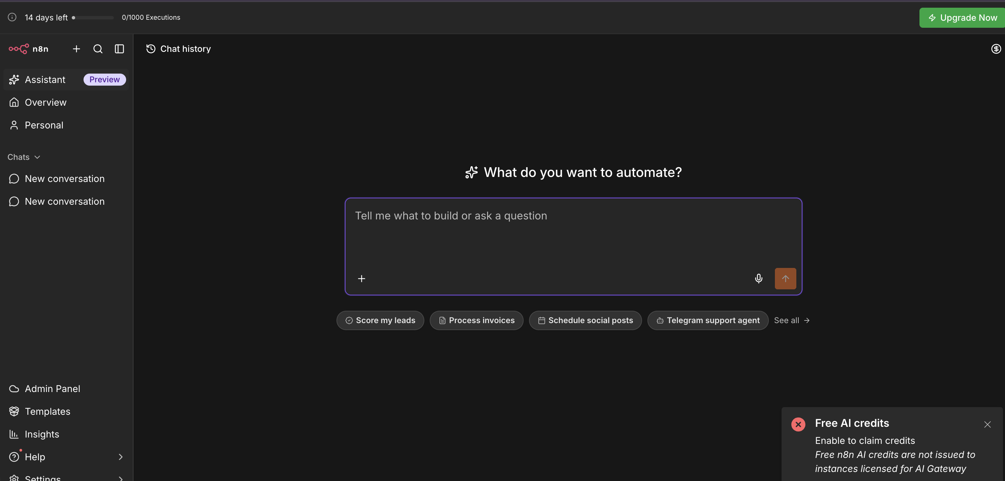
TOPIC 1 · AI-ASSISTED WORKFLOW CREATION
n8n Assistant — Describe It, n8n Builds It
Open Assistant in the left sidebar and answer "What do you want to automate?". It plans, builds and tests a normal n8n workflow you can inspect, edit and publish. Assistant chats use the plan's monthly Assistant credits.
Automate Business Processes with Agentic AI Workflows · C209
© 2026 Tertiary Infotech Academy Pte Ltd
27

Slide 28
TOPIC 1 · DEMO
Demo: Build a Social Media Campaign Workflow with n8n Assistant
Give n8n Assistant one clear prompt — it plans and builds the workflow below, with a human approval gate.
Form Trigger
you enter a topic
Research
AI Agent + web search
Draft post
AI writes the copy
Human in the loop
email approve / reject
Schedule post
wait, then publish
▶
▶
▶
▶
THE PROMPT
THEN YOU
Create a workflow for a social media marketing campaign:
1. Start from a form where I enter a campaign topic.
2. Research the topic on the web and summarise 3 key points.
3. Draft a LinkedIn post under 150 words from the research.
4. Email me the draft and wait for my approval before posting.
5. If approved, schedule the post for 9am the next weekday;
if rejected, log my feedback in a Google Sheet.
Use Gateway credits for the AI model. Ask me before publishing.
• Review the plan before it builds
• Connect Gmail and the social account when it asks
• Test with a real topic and approve the draft
• Publish only when the run looks right
The AI built it; the workflow runs it — and nothing is posted until a person approves the draft.
Automate Business Processes with Agentic AI Workflows · C209
© 2026 Tertiary Infotech Academy Pte Ltd
28

Slide 29
TOPIC 1 · n8n FUNDAMENTALS
Trigger Nodes — What Is Allowed to Start a Workflow
The trigger you choose is a statement about who or what may start the process.
1
Manual Trigger
2
Schedule Trigger
3
Form Trigger
Click Execute workflow. For building and testing, and for one-off jobs such as the Lab 5 ingestion run.
A clock starts the workflow — an interval or a cron expression. Nightly reports, reminders and syncs.
n8n hosts a web form for you and each submission starts a run. This is Lab 1's front door.
4
Webhook
5
Chat Trigger
6
App & Email Triggers
An external system calls a URL you expose. Your own website, app or CRM — Labs 2, 3, 4 and 5.
Each message in n8n's built-in chat window starts a run — the quickest way to talk to an agent while building.
On new Gmail, new Sheets row, new Drive file. React to changes in the apps you already use.
Pick the trigger by asking: who or what should be allowed to start this process?
Automate Business Processes with Agentic AI Workflows · C209
© 2026 Tertiary Infotech Academy Pte Ltd
29

Slide 30
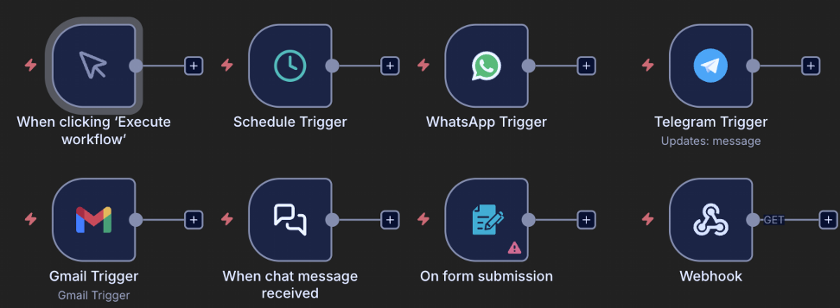
TOPIC 1 · n8n FUNDAMENTALS
Trigger Nodes on the n8n Canvas
n8n trigger nodes: Manual · Schedule · WhatsApp · Telegram · Gmail · Chat · Form · Webhook
Automate Business Processes with Agentic AI Workflows · C209
© 2026 Tertiary Infotech Academy Pte Ltd
30

Slide 31
TOPIC 1 · n8n FUNDAMENTALS
Triggers Used in This Course
Every lab's trigger, and why that trigger is the right front door for that business process.
Trigger
Where
Why it fits
Form Trigger
Lab 1
A visitor's event sign-up must start the workflow
Webhook — POST
Labs 2, 3, 4, 5
A website sends JSON and waits for the agent's reply
Manual Trigger
Lab 5 ingestion
A human loads the documents once, by hand
Schedule Trigger
Not used in class
Nightly reports and reminders — same pattern, a clock instead
Chat Trigger
Optional while building
Talk to an agent without building a website first
Swap the front door and keep the workflow — the trigger is the only part that has to change.
Automate Business Processes with Agentic AI Workflows · C209
© 2026 Tertiary Infotech Academy Pte Ltd
31

Slide 32
TOPIC 1 · n8n FUNDAMENTALS
Data-Processing Nodes — The Workhorses
Between the trigger and the output, these nodes shape, route and transform the data.
1
Edit Fields (Set)
2
IF / Switch
3
Filter
4
Merge
Add, rename or reshape fields — the node you reach for first when the data is the wrong shape. Used in Labs 2 and 4.
Branch the workflow. IF gives a true and a false path; Switch gives one path per case. Lab 4 routes Approve vs Decline.
Let only the matching items continue and drop the rest of the list.
Combine two branches — append the rows, match them by key, or choose one side.
5
Split Out / Aggregate
6
Code
7
Loop / Wait
8
HTTP Request
Turn one item holding a list into many items — and back again.
JavaScript or Python for the 5% a built-in node cannot do. Lab 3 uses it to normalise the chat message.
Process items in batches, or pause a workflow for a period of time or an event.
Call any API on the internet — the universal escape hatch when no integration exists.
Most workflows are: trigger → reshape (Set) → decide (IF) → act (app node). Reach for Code last.
Automate Business Processes with Agentic AI Workflows · C209
© 2026 Tertiary Infotech Academy Pte Ltd
32

Slide 33

TOPIC 1 · n8n FUNDAMENTALS
Data-Processing Nodes on the Canvas
If · Switch · Filter · Edit Fields · Split Out · Aggregate · Merge · Loop · Date & Time · Wait · Code
Automate Business Processes with Agentic AI Workflows · C209
© 2026 Tertiary Infotech Academy Pte Ltd
33

Slide 34
TOPIC 1 · n8n FUNDAMENTALS
Where the Data Goes — Storage & App Actions
Action nodes that write the result somewhere useful, or send it to a person.
1
Google Sheets
2
Gmail / Outlook
A real spreadsheet you keep, connected with OAuth2. Append Row is the workhorse — Labs 2 and 4 log every decision here.
Send a message — and in Lab 4, Send and Wait for Response, which turns email into an approval gate.
3
Vector Store
4
Respond to Webhook
Store embeddings for RAG. In-memory for class, Pinecone / Supabase / Qdrant for production — Lab 5.
Return data to whoever called the webhook, so a web page can render the agent's answer.
Anything you must keep goes to external storage — an in-memory store vanishes when n8n restarts.
Automate Business Processes with Agentic AI Workflows · C209
© 2026 Tertiary Infotech Academy Pte Ltd
34

Slide 35
TOPIC 1 · n8n FUNDAMENTALS
JSON and Expressions — How Data Moves
Every node passes a list of items; each item is a JSON object of key/value pairs.
• JSON (JavaScript Object Notation) is a simple text format for data.
• Values can be text, numbers, true/false, lists [ ] or nested objects { }.
• Most APIs send and receive JSON — and so does every n8n node.
• Click any node to inspect the JSON going in and coming out.
ONE FORM SUBMISSION AS JSON
{
"Name": "Alice Tan",
"Email": "alice@corp.com",
"Phone": "91234567",
"Message": "Please reserve 2 seats"
}
Read any value later with an expression: {{ $json.Name }} → "Alice Tan"
Automate Business Processes with Agentic AI Workflows · C209
© 2026 Tertiary Infotech Academy Pte Ltd
35

Slide 36
TOPIC 1 · n8n FUNDAMENTALS
Test vs Production Executions
The same workflow runs in two modes — always know which one you are looking at.
TEST — in the editor
PRODUCTION — after you click Publish
• Click Execute workflow to run it once.
• The data is shown live on the canvas, node by node.
• Pin a node's output to freeze it while you build downstream.
• Perfect while building — nothing needs to be published.
• Runs automatically whenever the trigger fires.
• Nothing appears on the canvas — runs are logged under Executions.
• Every run records status, timing and the full data at each node.
• This is what your users actually experience.
The Executions list is the honest account of what happened — debug from there, not from memory.
Automate Business Processes with Agentic AI Workflows · C209
© 2026 Tertiary Infotech Academy Pte Ltd
36

Slide 37

TOPIC 1 · n8n FUNDAMENTALS
Execution History
The Executions tab — every run shows its status, duration, ID and the full data at each node
Automate Business Processes with Agentic AI Workflows · C209
© 2026 Tertiary Infotech Academy Pte Ltd
37

Slide 38
TOPIC 1 · n8n FUNDAMENTALS
Credentials — Connect Your Accounts Once
Nodes reference credentials by NAME. Set each one up once under Credentials → Add credential.
1
Gmail (OAuth2)
2
Google Gemini (API key)
Sign in with Google and grant access. Used from Lab 1 onward for sending mail and for the Lab 4 approval gate.
The LLM behind every agent in this course, and the embedding model in Lab 5.
3
Google Sheets (OAuth2)
4
Google Drive (OAuth2)
The audit log in Labs 2 and 4 — customer records, decisions, drafts and approvals.
The brochure folder that Lab 5's ingestion workflow reads from.
Imported workflows carry credential NAMES, not secrets — always re-select your own after importing.
Automate Business Processes with Agentic AI Workflows · C209
© 2026 Tertiary Infotech Academy Pte Ltd
38

Slide 39
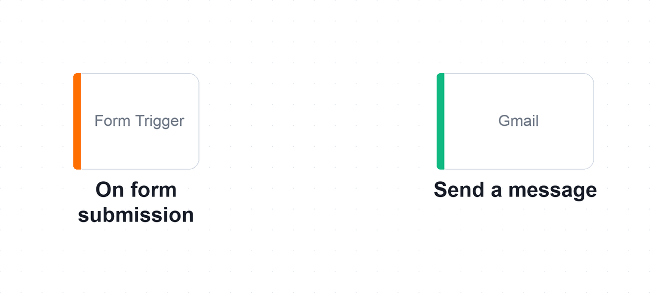
TOPIC 1 · n8n AND AI AGENTS · LAB WORKFLOW
Lab 1 — n8n Trigger and Action (Event Flyer with QR Code)
Your first n8n workflow: a form emails each sign-up to the administrator, then you publish it and put its QR code on an event flyer.
Form Trigger
visitor submits the sign-up
Gmail — Send a message
administrator is emailed
Publish
copy the Production URL
QR code flyer
anyone scans to sign up
▶
▶
▶
The Lab 1 workflow on the n8n canvas. Two nodes: the Form Trigger decides WHEN the workflow runs, and the Gmail node decides WHAT it does.
LAB 1
n8n Trigger and Action (Event Flyer with QR Code)
Form Trigger → Gmail (Send a message) → Publish → QR-code flyer · full click-by-click steps in the Learner Guide
Automate Business Processes with Agentic AI Workflows · C209
© 2026 Tertiary Infotech Academy Pte Ltd
39

Slide 40

LAB 1 · THE APPLICATION
Lab 1 — n8n Trigger and Action — What You'll Build
• The finished Lab 1 workflow on the n8n canvas — the Form Trigger fires on each submission and the Gmail node sends the details to the administrator.
• A trigger decides when a workflow runs; an action decides what it does.
• Expressions such as {{ $json.Name }} carry data from one node to the next.
Automate Business Processes with Agentic AI Workflows · C209
© 2026 Tertiary Infotech Academy Pte Ltd
40

Slide 41
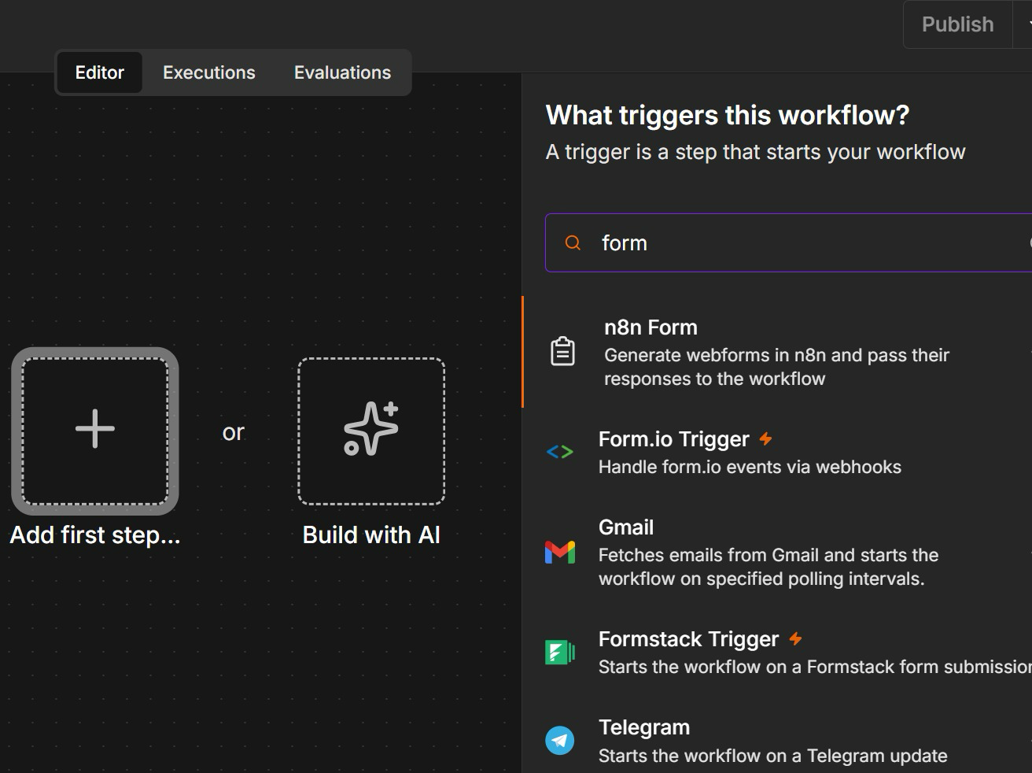
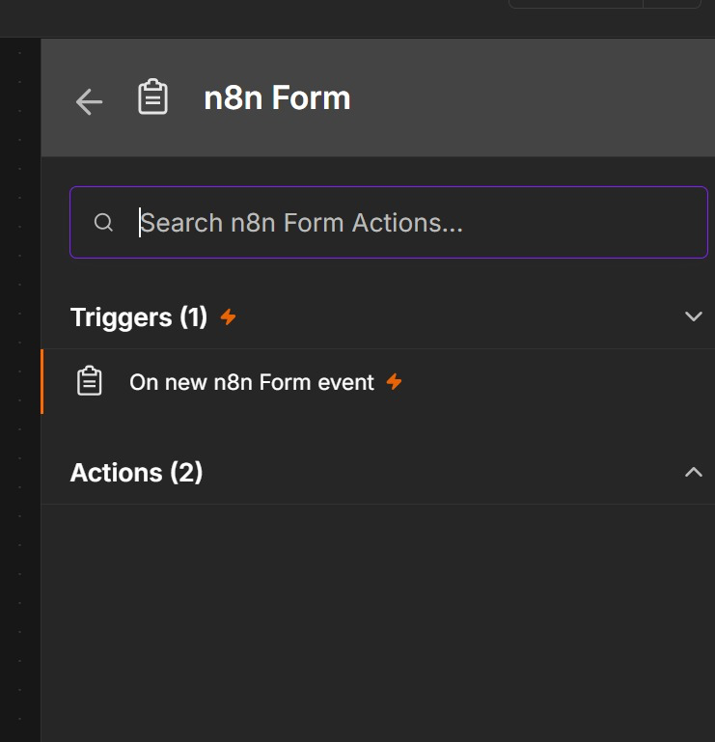
LAB 1 · STEP BY STEP
Lab 1 — Step 1: Add the n8n Form Trigger
Click Add first step (+), search 'form' and choose n8n Form → On new n8n Form event. Then add the Name, Email, Phone and Message fields.
Automate Business Processes with Agentic AI Workflows · C209
© 2026 Tertiary Infotech Academy Pte Ltd
41

Slide 42
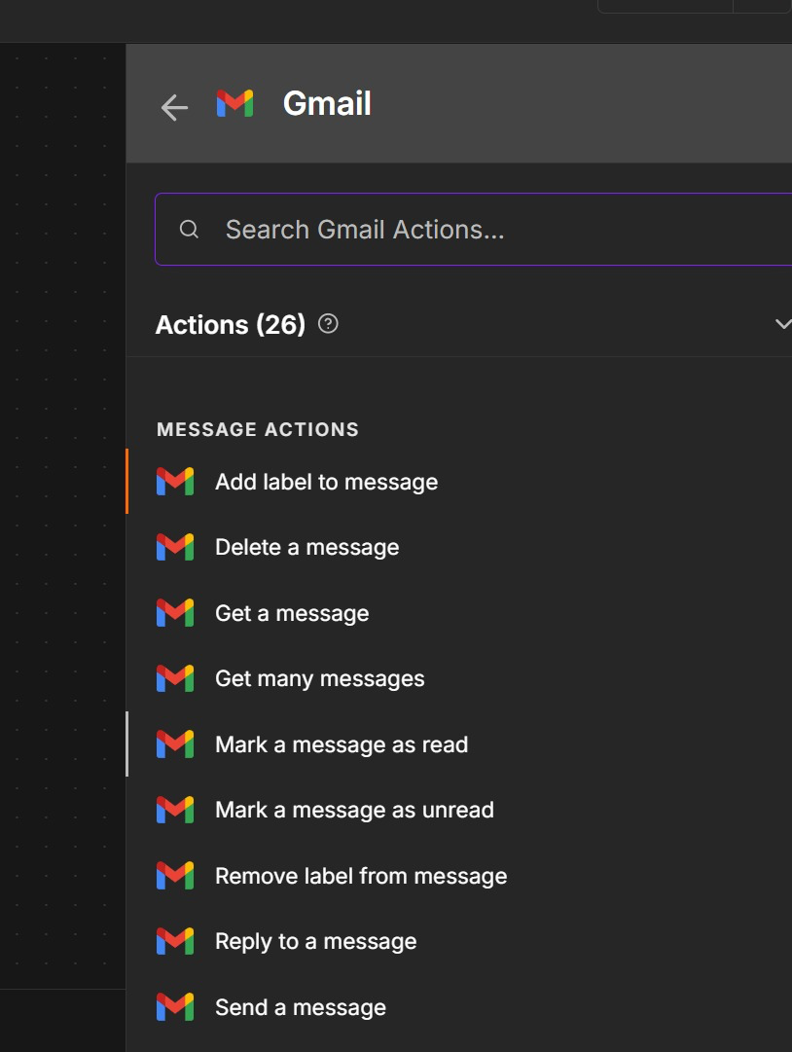
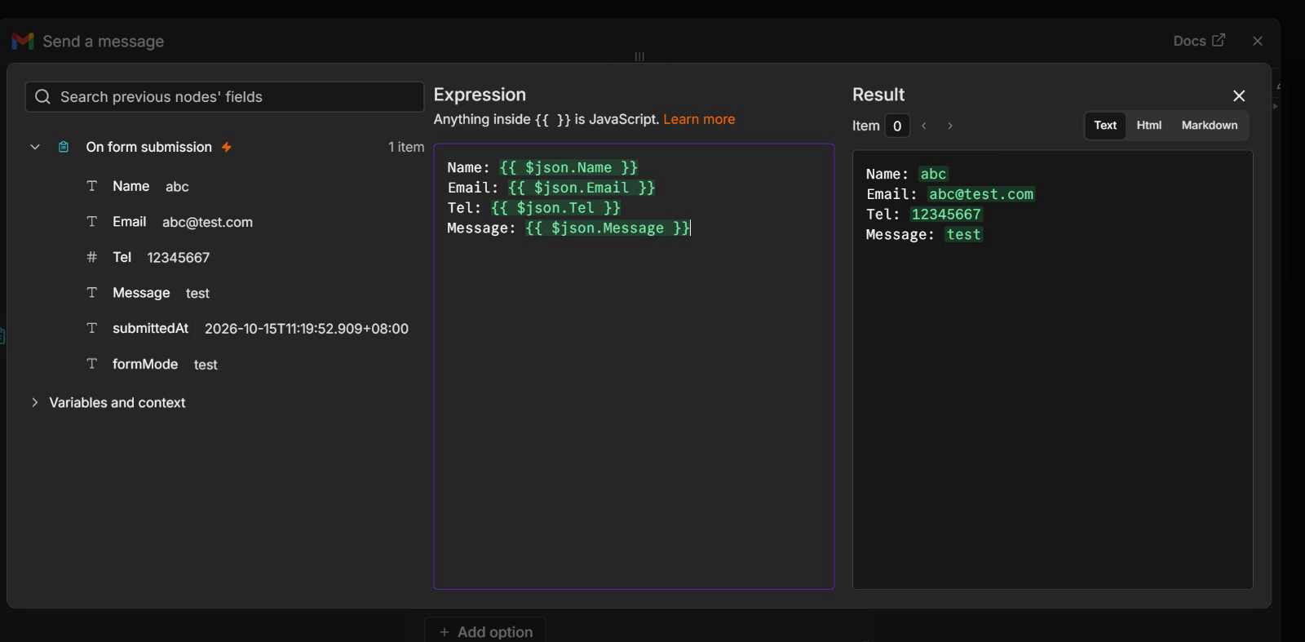
LAB 1 · STEP BY STEP
Lab 1 — Step 2: Gmail — Send a Message with Expressions
Add Gmail → Send a message. Switch Message to Expression and drag in the form fields — the Result panel previews the email before you run it.
Automate Business Processes with Agentic AI Workflows · C209
© 2026 Tertiary Infotech Academy Pte Ltd
42

Slide 43
LAB 1 · STEP BY STEP
Lab 1 — Step 3: Publish and Copy the Production URL
1
2
3
4
5
▶
▶
▶
▶
Test first: Execute workflow, submit the test form, check the email arrives
Click Publish (top right of the editor) — the workflow is now live
Open the Form Trigger node
Switch the form URL from Test URL to Production URL
Copy the Production URL — this is what the QR code will open
The Test URL answers one submission while you watch; a PUBLISHED workflow's Production URL works for everyone.
Automate Business Processes with Agentic AI Workflows · C209
© 2026 Tertiary Infotech Academy Pte Ltd
43

Slide 44
LAB 1 · STEP BY STEP
Lab 1 — Step 4: Create a Flyer with the QR Code
1
2
3
4
5
▶
▶
▶
▶
Paste the Production URL into alfredang.github.io/qrcodegenerator
Download the QR code as a PNG
Design the flyer — Canva, PowerPoint or an AI image tool
Add the QR code with a clear 'Scan to register' call-to-action
Present it — classmates scan, register, and the admin is emailed
A two-node workflow is now a real sign-up channel: anyone with a phone can register by scanning your flyer.
Automate Business Processes with Agentic AI Workflows · C209
© 2026 Tertiary Infotech Academy Pte Ltd
44

Slide 45
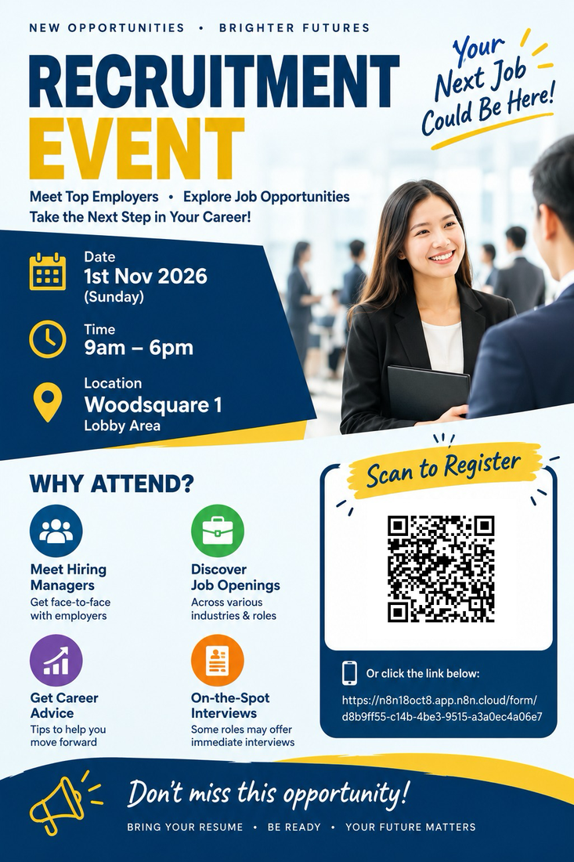



LAB 1 · INSPIRATION
Lab 1 — Flyers from Previous Learners
Each QR code encodes the form's Production URL — scan it, register, and the event administrator receives the details by email.
Automate Business Processes with Agentic AI Workflows · C209
© 2026 Tertiary Infotech Academy Pte Ltd
45

Slide 46
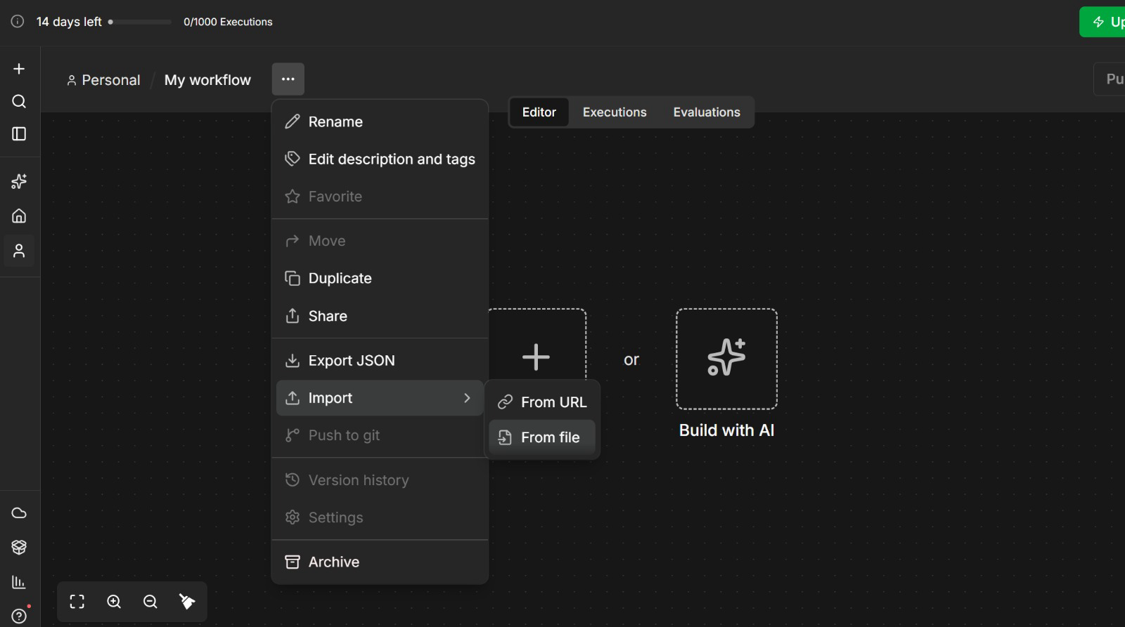
LAB 1 · STEP BY STEP
Lab 1 — Compare with the Reference Solution
Create a NEW workflow, open the '...' menu → Import → From File and pick Lab 1 - Event Flyer with QR Code.json, so your own build is not overwritten.
Automate Business Processes with Agentic AI Workflows · C209
© 2026 Tertiary Infotech Academy Pte Ltd
46

Slide 47
LAB 1 · VERIFY AND DEBRIEF
Lab 1 — n8n Trigger and Action
Scan the QR code on your flyer with your phone, submit the form, and confirm the administrator's inbox receives the email with the details you typed. A reference solution is provided as labs/lab1-trigger-actions/Lab 1 - Event Flyer with QR Code.json — build yours by hand first, then import it to compare.
1
Triggers and actions
2
Expressions
A trigger decides when a workflow runs; an action decides what it does.
Expressions such as {{ $json.Name }} carry data from one node to the next.
3
Test vs Production URL
The Test URL works only while you are listening; the Production URL works once the workflow is published.
Lab 1 — you can now build an automated workflow in n8n using a trigger and an action.
Automate Business Processes with Agentic AI Workflows · C209
© 2026 Tertiary Infotech Academy Pte Ltd
47

Slide 48
Lunch Break
30 minutes
Automate Business Processes with Agentic AI Workflows · C209
© 2026 Tertiary Infotech Academy Pte Ltd
48

Slide 49
TOPIC 1 · AI AGENT BUILDING BLOCKS
Before Lab 2 — The Building Blocks of an AI Agent
Lab 1 was a trigger and an action. Lab 2 adds an AI Agent that decides — these six blocks are what it is made of.
AI Agent
the hub that decides
Model
the LLM brain
Tools & MCP
what it may do
Instructions
the rules it follows
Memory
what it remembers
Webhook
how the world calls it
▶
▶
▶
▶
▶
1
What Lab 1 had
2
What Lab 2 adds
3
What changes at the front door
A Form Trigger and a Gmail action. Every submission follows the same fixed path — no judgement anywhere.
An AI Agent node with a model, three tools and the bank's rules, deciding APPROVED, REJECTED, REVIEW or DUPLICATE.
The n8n form is replaced by a real bank website that POSTs to a Webhook and reads the decision back.
Learn the six blocks one at a time, then watch them work together in Lab 2.
Automate Business Processes with Agentic AI Workflows · C209
© 2026 Tertiary Infotech Academy Pte Ltd
49

Slide 50
TOPIC 1 · AI AGENT BUILDING BLOCKS
What Is an AI Agent? — The Agent Loop
Given a goal, an agent does not answer once. It works in a loop until the goal is met.
Context
goal, rules, memory, data
Plan
decide the next step
Action
call a tool
Verify
check against the goal
Repeat
until done, then answer
▶
▶
▶
▶
1 · Context
2 · Plan
3 · Action
4 · Verify and repeat
Everything the agent can see: the goal, its instructions, memory of the conversation, and what earlier tool calls returned.
The LLM reasons over the context and chooses the next step — which tool to call, with what input, or whether it is finished.
The agent calls a tool: look up a record, write a row, send an email. This is where it acts on the world.
The tool's result goes back into the context and is checked against the goal. Not done? Plan again. Done? Reply.
Every turn of the loop is an LLM call — so cap it (Max Iterations on the AI Agent node) and log every step.
Automate Business Processes with Agentic AI Workflows · C209
© 2026 Tertiary Infotech Academy Pte Ltd
50

Slide 51
TOPIC 1 · AI AGENT BUILDING BLOCKS
Components of an AI Agent
Four parts around one hub: the AI Agent node wires them together, and every agent in this course is exactly these four.
MODEL
MEMORY
The LLM 'brain' — interprets language, reasons and chooses the next step. Google Gemini in this course.
Keeps the conversation so follow-up questions still make sense. Keyed on a session ID, per visitor.
THE AI AGENT
plans · decides · calls tools
TOOLS
INSTRUCTIONS
The abilities it may use: look up a Sheets row, search a vector store, send an email, call an API.
The system message — identity, scope, rules and refusals. Always in force, on every single turn.
Model + Memory + Tools + Instructions. Change any one of the four and you have a different agent.
Automate Business Processes with Agentic AI Workflows · C209
© 2026 Tertiary Infotech Academy Pte Ltd
51

Slide 52
TOPIC 1 · AI AGENT BUILDING BLOCKS
The Model — Popular LLM Providers
Any chat model plugs into the same AI Agent node. n8n lists each provider's live models — swap the brain, keep the agent.
Provider
Models
Notes
Google
Gemini 4 Argon · Gemini 3.8 Flash · Gemini 3.1 Pro
Course default (Gemini Flash) — also supplies the embeddings in Lab 5
OpenAI
GPT-6 Astra · GPT-6.1 Sol · GPT-6 Luna
Newest family; GPT-5.x models remain in the API
Anthropic
Claude Opus 5.5 · Sonnet 5.5 · Haiku 5.5
Strong reasoning and long context; Haiku is fast and cheap
Meta
Llama 4 (Scout, Maverick)
Open weights — can be self-hosted, e.g. with Ollama
Mistral
Mistral Large 4 · Mistral Medium 3.5
A European option, with open-weight models too
Pick by task: small fast models for classification and guardrails, larger models for reasoning.
Automate Business Processes with Agentic AI Workflows · C209
© 2026 Tertiary Infotech Academy Pte Ltd
52

Slide 53
TOPIC 1 · AI AGENT BUILDING BLOCKS
Model Parameters — Temperature and Friends
Settings on the chat-model node shape HOW the model answers. The most important by far is temperature.
1
Temperature 0 – 0.3
2
Temperature ≈ 0.7
3
Temperature 1.0 +
Deterministic and repeatable. Use for classification, compliance decisions and data extraction — automation that must give the same answer twice.
Balanced. Natural-sounding conversation with some variety — the usual default for a customer-facing assistant.
Creative and surprising. Marketing copy and brainstorming — never for a decision that must be defended.
1
Top-p
2
Max tokens
3
Frequency / presence penalty
An alternative sampling control that limits the model to the most probable tokens. Tune temperature OR top-p, never both.
Caps the length of the reply. Protects your cost and keeps chat answers short enough to read.
Discourage repetition and nudge the model onto new topics — useful for long generations, rarely for automation.
For business automation keep the temperature LOW — Lab 3 uses 0.2 so the same question is refused the same way every time.
Automate Business Processes with Agentic AI Workflows · C209
© 2026 Tertiary Infotech Academy Pte Ltd
53

Slide 54
TOPIC 1 · FREE AI CREDITS
Claim Your Free AI Credits
1
2
3
4
5
▶
▶
▶
▶
Sign in to n8n Cloud with your training account — the free trial includes Gateway credits
Open a workflow and add an AI node, e.g. AI Agent → Gemini or OpenAI Chat Model
In the node's Credential field, choose Use Gateway credits — your balance shows beside it
Pick a supported model and run the node — no provider account or API key needed
Track the balance on the node, or in Admin Panel → Gateway credits
A red "Free AI credits — Enable to claim credits" toast is the legacy OpenAI offer: Gateway instances don't get it. Use Gateway credits.
Automate Business Processes with Agentic AI Workflows · C209
© 2026 Tertiary Infotech Academy Pte Ltd
54

Slide 55
TOPIC 1 · AI AGENT BUILDING BLOCKS
Tools — What the Agent May Do
Attach tools to the agent's Tool input. The model decides WHEN to call one, based on the description you write.
1
Google Sheets tool
2
Vector Store tool
Look up or write structured records. Lab 2 attaches three: check for a duplicate, create the customer, send the confirmation.
Retrieve document chunks for a grounded answer — the Query Data Tool in Lab 5.
3
HTTP Request tool
4
Sub-workflow tool
Call any external API in the middle of a conversation — prices, stock levels, a CRM record.
Wrap an entire n8n workflow as one callable tool, so your own logic becomes something the agent can invoke.
The tool DESCRIPTION is how the agent knows when to call it — write it for the model, not for a developer.
Automate Business Processes with Agentic AI Workflows · C209
© 2026 Tertiary Infotech Academy Pte Ltd
55

Slide 56
TOPIC 1 · AI AGENT BUILDING BLOCKS
MCP — Model Context Protocol
An open standard that gives agents a common plug for tools and data, instead of one custom integration per pair.
AI Agent
any MCP-capable client
MCP Client
speaks the protocol
MCP Server
exposes tools + data
Your Systems
databases, APIs, files
▶
▶
▶
Without MCP
With MCP
Every agent × every tool needs its own custom integration. N agents and M tools means N × M connectors to build and to maintain.
Build ONE MCP server per system and any MCP-capable agent can use it. N + M pieces, and the tools become reusable across agents.
MCP is like USB-C for AI tools — one connector, many devices.
Automate Business Processes with Agentic AI Workflows · C209
© 2026 Tertiary Infotech Academy Pte Ltd
56

Slide 57
TOPIC 1 · AI AGENT BUILDING BLOCKS
MCP in n8n
n8n sits on both sides of the protocol — it can serve tools to other agents, and borrow tools for its own.
MCP SERVER TRIGGER — n8n serves tools
MCP CLIENT TOOL — n8n consumes tools
• Expose your own n8n workflows AS tools over MCP.
• Claude, an IDE or another agent can then call your workflows directly.
• n8n becomes the tool layer for any MCP client.
• Secured with a bearer token on the server URL.
• Attach an external MCP server to your n8n AI Agent.
• The agent gains all of that server's tools with no custom node.
• Mix MCP tools and native n8n tools freely on the same agent.
• Same agent loop — simply more reach.
Two directions, one protocol. Build the tool once and every agent you own can use it.
Automate Business Processes with Agentic AI Workflows · C209
© 2026 Tertiary Infotech Academy Pte Ltd
57

Slide 58
TOPIC 1 · AI AGENT BUILDING BLOCKS
Instructions — The Four Parts That Constrain
The system message is always in force. Every good agent instruction in this course states four things.
1
Identity
2
Source rules
Who the agent is, and for whom. 'You are the onboarding assistant for Marina Trust Bank.' Narrow roles refuse far more reliably than general assistants.
Where answers may come from. 'Answer ONLY from the brochures returned by the tool — never from general knowledge.'
3
Refusals
4
Escalation
What is out of bounds, stated explicitly. 'Never recommend a product, predict a return, or guarantee an outcome.'
What to do at the boundary. 'If you are not sure, say so and offer a consultation with a licensed adviser.'
Vague instructions produce confident wrong answers — every rule you skip, the model improvises.
Automate Business Processes with Agentic AI Workflows · C209
© 2026 Tertiary Infotech Academy Pte Ltd
58

Slide 59
TOPIC 1 · AI AGENT BUILDING BLOCKS
Examples of Good and Bad Instructions
The same chatbot, two system messages — one is testable, the other is a hope.
✗ TOO VAGUE
✓ CONSTRAINED AND TESTABLE
"You are a helpful assistant. Answer the user's questions politely."
"You are the enquiry assistant for Meridian Asset Management.
Answer only questions about our services, fees and appointment booking.
Use the brochure search tool for any factual question — never answer from general knowledge.
Never recommend a product, predict a return, or guarantee an outcome.
If you are not sure, say so and offer a call with a licensed adviser."
No identity · no source rules · no refusals · no escalation.
It will happily invent a price and guarantee an investment return — politely.
Identity · source rules · refusals · escalation — you can test each line by trying to break it.
Automate Business Processes with Agentic AI Workflows · C209
© 2026 Tertiary Infotech Academy Pte Ltd
59

Slide 60
TOPIC 1 · AI AGENT BUILDING BLOCKS
Memory — Why the Agent Remembers
Without memory every message is from a stranger; with it, 'what about next month?' still makes sense.
Msg 1: 'What courses do you run?'
agent answers from its tools
Stored in memory
keyed by session ID
Msg 2: 'How much is that one?'
agent knows which course
Window slides
only the last N turns are kept
▶
▶
▶
1
Window buffer memory
2
Session key
3
Sometimes you want NO memory
Keeps the last N exchanges of THIS conversation. It is n8n's default and it is what Lab 3's chatbot uses.
Memory is per session ID, so two visitors on the same website never see each other's conversation.
Lab 2's onboarding agent deliberately has none — one applicant's details must never influence the next decision.
Memory is conversation context, NOT long-term knowledge. Facts belong in tools and documents (RAG).
Automate Business Processes with Agentic AI Workflows · C209
© 2026 Tertiary Infotech Academy Pte Ltd
60

Slide 61
TOPIC 1 · AI AGENT BUILDING BLOCKS
Structured Output — Making an Agent's Answer Usable
By default an agent returns a paragraph of prose. Prose cannot be branched on, sorted, counted or coloured.
1
Attach an Output Parser
2
Name the fields you will act on
A Structured Output Parser forces named fields instead of free text — Labs 2 and 4 both use one.
Lab 2 returns decision, reason and riskFlags. The website colours its result card from decision alone.
3
Enumerate the allowed values
4
Everything downstream depends on it
APPROVED / REJECTED / REVIEW / DUPLICATE. A closed list is what makes an IF node reliable.
An IF node routes on it, a Sheets node logs it, and a queue is sorted by it. Prose supports none of that.
If something downstream must act on the answer, make the answer a field — not a sentence.
Automate Business Processes with Agentic AI Workflows · C209
© 2026 Tertiary Infotech Academy Pte Ltd
61

Slide 62
TOPIC 1 · WEBHOOKS
What Is a Webhook?
A URL your workflow listens on. When the outside world calls it, your workflow runs — the reverse of you calling an API.
Event happens
a visitor submits the form
HTTP request to your URL
the website POSTs JSON
Workflow runs
n8n receives the data as its input
Respond to Webhook
your reply returns to the caller
▶
▶
▶
1
Push, not pull
2
Any caller
3
A paired node
No polling and no schedule — the caller notifies you the moment something happens.
Websites, payment providers, forms, CRMs, mobile apps — anything that can send an HTTP request.
The Webhook node starts the workflow; Respond to Webhook sends the answer back on the same connection.
A webhook is the reverse of an API call — the outside world calls YOU when an event happens.
Automate Business Processes with Agentic AI Workflows · C209
© 2026 Tertiary Infotech Academy Pte Ltd
62

Slide 63

TOPIC 1 · WEBHOOKS
Webhook Nodes in n8n
The Webhook node starts the workflow when it is called; Respond to Webhook returns data to the caller
Automate Business Processes with Agentic AI Workflows · C209
© 2026 Tertiary Infotech Academy Pte Ltd
63

Slide 64
TOPIC 1 · WEBHOOKS
Webhook vs HTTP Request — Which Way the Call Goes
Both are plain HTTP. The only difference is who dials.
WEBHOOK — inbound
HTTP REQUEST — outbound
• An external service calls YOUR workflow.
• You react the moment the event happens.
• It is the TRIGGER — always the first node.
• Labs 2–5: the lab website calls your agent.
• YOUR workflow calls an external service.
• You pull the data at a moment you choose.
• It is an ACTION inside the workflow.
• Use it to reach any API with no dedicated n8n node.
Same HTTP underneath — a webhook receives a call, an HTTP Request makes one.
Automate Business Processes with Agentic AI Workflows · C209
© 2026 Tertiary Infotech Academy Pte Ltd
64

Slide 65

TOPIC 1 · WEBHOOKS
The HTTP Request Node
The HTTP Request node calls out to any API — the outbound counterpart to an inbound webhook
Automate Business Processes with Agentic AI Workflows · C209
© 2026 Tertiary Infotech Academy Pte Ltd
65

Slide 66
TOPIC 1 · WEBHOOKS
HTTP Methods on a Webhook — GET vs POST
The method is part of the contract with the caller: where the data rides, and what the call means.
GET — read
POST — send
• The data rides in the URL query string:
– ?email=alice@corp.com
• A browser can call it just by visiting the URL.
• Read it in n8n as {{ $json.query.email }}.
• Right for: a dashboard pulling data to display.
• The data rides in the request body as JSON:
– { "message": "How much is the course?" }
• This is what a web form or a chat widget sends.
• Read it in n8n as {{ $json.body.message }}.
• Right for: Labs 2–5, where the site submits data.
GET reads, POST sends. Set the method on the Webhook node — and the caller must match it exactly.
Automate Business Processes with Agentic AI Workflows · C209
© 2026 Tertiary Infotech Academy Pte Ltd
66

Slide 67
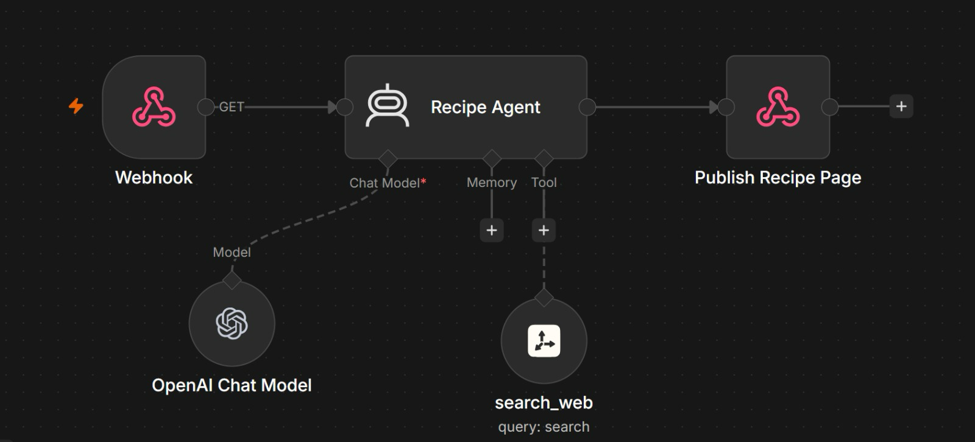
TOPIC 1 · WEBHOOKS
Example: A GET Webhook That Publishes a Recipe Page
One URL, one agent, one page back. A webhook does not have to sit behind a form — opening a link can run an agent.
1
Webhook — GET
2
Recipe Agent
3
search_web tool
4
Page back
Opening the URL in a browser is the request. Anything the agent needs can ride in the query string.
An OpenAI chat model writes the recipe. There is no memory: each request stands alone.
The agent calls search_web, passing a search query, when it needs facts from the web.
Publish Recipe Page (a Respond to Webhook node) returns the page, so the browser shows it at once.
GET suits a link anyone can click. Lab 2's bank form uses POST, because it sends a body of applicant data.
Automate Business Processes with Agentic AI Workflows · C209
© 2026 Tertiary Infotech Academy Pte Ltd
67

Slide 68
TOPIC 1 · WEBHOOKS
Webhook Test URL vs Production URL
Every Webhook node gives you TWO URLs. They behave differently, and confusing them is the single most common webhook bug.
TEST URL — /webhook-test/…
PRODUCTION URL — /webhook/…
• Works only while you have clicked 'Listen for test event'.
• Handles exactly ONE call, then stops listening.
• The run appears live on the canvas — ideal for debugging.
• Dies the moment you leave the editor.
• Requires the workflow to be published (Publish, top right).
• Always on — every call starts a run.
• Runs are logged under Executions, not drawn on the canvas.
• This is the URL you give to a website, an app or a QR code.
Your website must call the PRODUCTION URL of a PUBLISHED workflow — the Test URL is spent after one request.
Automate Business Processes with Agentic AI Workflows · C209
© 2026 Tertiary Infotech Academy Pte Ltd
68

Slide 69
TOPIC 1 · WEBHOOKS
Configuring the Webhook Node
Four settings decide whether the browser's call actually succeeds.
1
Method + Path
2
Allowed Origins (CORS)
GET or POST, and the path that ends your URL — for example POST /webhook/marina-trust-onboarding.
Browsers block cross-site calls unless you allow them. Set * in class so a local HTML page can call n8n; never leave * in production.
3
Response mode
4
Authentication
Immediately (a bare acknowledgement), when the workflow finishes, or via a Respond to Webhook node — every lab here uses the last one.
None for a classroom demo; Basic, Header or JWT for anything real. A public URL is a public door, and every call costs you model tokens.
'Failed to fetch' in the browser is almost always CORS or a dead Test URL — check those two first.
Automate Business Processes with Agentic AI Workflows · C209
© 2026 Tertiary Infotech Academy Pte Ltd
69

Slide 70
LAB 2 · PUTTING IT TOGETHER
Lab 2 — Webhook and AI Agent — How the Building Blocks Fit
Website → Webhook → AI Agent → Respond. Every block you have just learned has one job in this lab.
Building block
In this lab
Why it matters
Webhook
Onboarding Webhook — POST /marina-trust-onboarding
The bank website's front door; Respond to Website returns the decision
AI Agent
Onboarding AI Agent
Applies the bank's onboarding rules and decides
Model
Google Gemini Chat Model (Gateway credits)
The LLM brain — keep the temperature low for repeatable decisions
Tools & MCP
check_duplicate_customer · create_customer_record · send_confirmation_email
The agent chooses when to call each one
Instructions
System message: eligibility rules, age check, four decisions
Where the bank's policy actually lives
Memory
None — deliberately
One applicant must never influence the next decision
Structured output
Decision Parser — decision, reason, riskFlags
Lets the page colour the result card
Six building blocks, one workflow: the webhook brings the applicant in, the agent decides, the page shows the result.
Automate Business Processes with Agentic AI Workflows · C209
© 2026 Tertiary Infotech Academy Pte Ltd
70

Slide 71
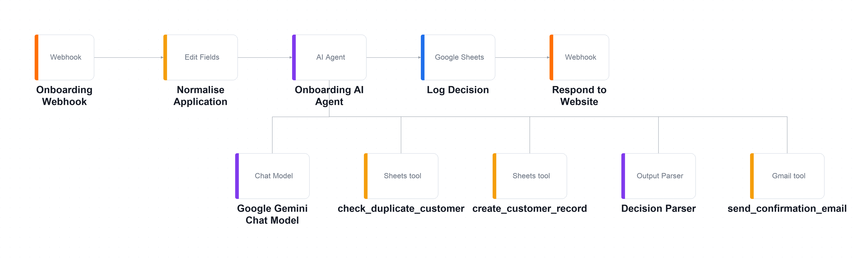
TOPIC 1 · n8n AND AI AGENTS · LAB WORKFLOW
Lab 2 — Webhook and AI Agent (Marina Trust Bank Onboarding)
Replace the n8n form with a real bank website that POSTs to a webhook, where an AI Agent applies the bank's onboarding rules using three tools.
Webhook — POST
the bank site submits
Normalise
Set node tidies the fields
AI Agent
+ 3 tools + parser
Log Decision
Google Sheets audit row
Respond
decision returns to the page
▶
▶
▶
▶
The Lab 2 workflow on the n8n canvas. The main chain runs left to right; the chat model, output parser and three tools hang below the agent on its Tool input.
LAB 2
Webhook and AI Agent (Marina Trust Bank Onboarding)
Webhook → Normalise → AI Agent (+3 tools) → Log Decision → Respond to Website · full click-by-click steps in the Learner Guide
Automate Business Processes with Agentic AI Workflows · C209
© 2026 Tertiary Infotech Academy Pte Ltd
71

Slide 72
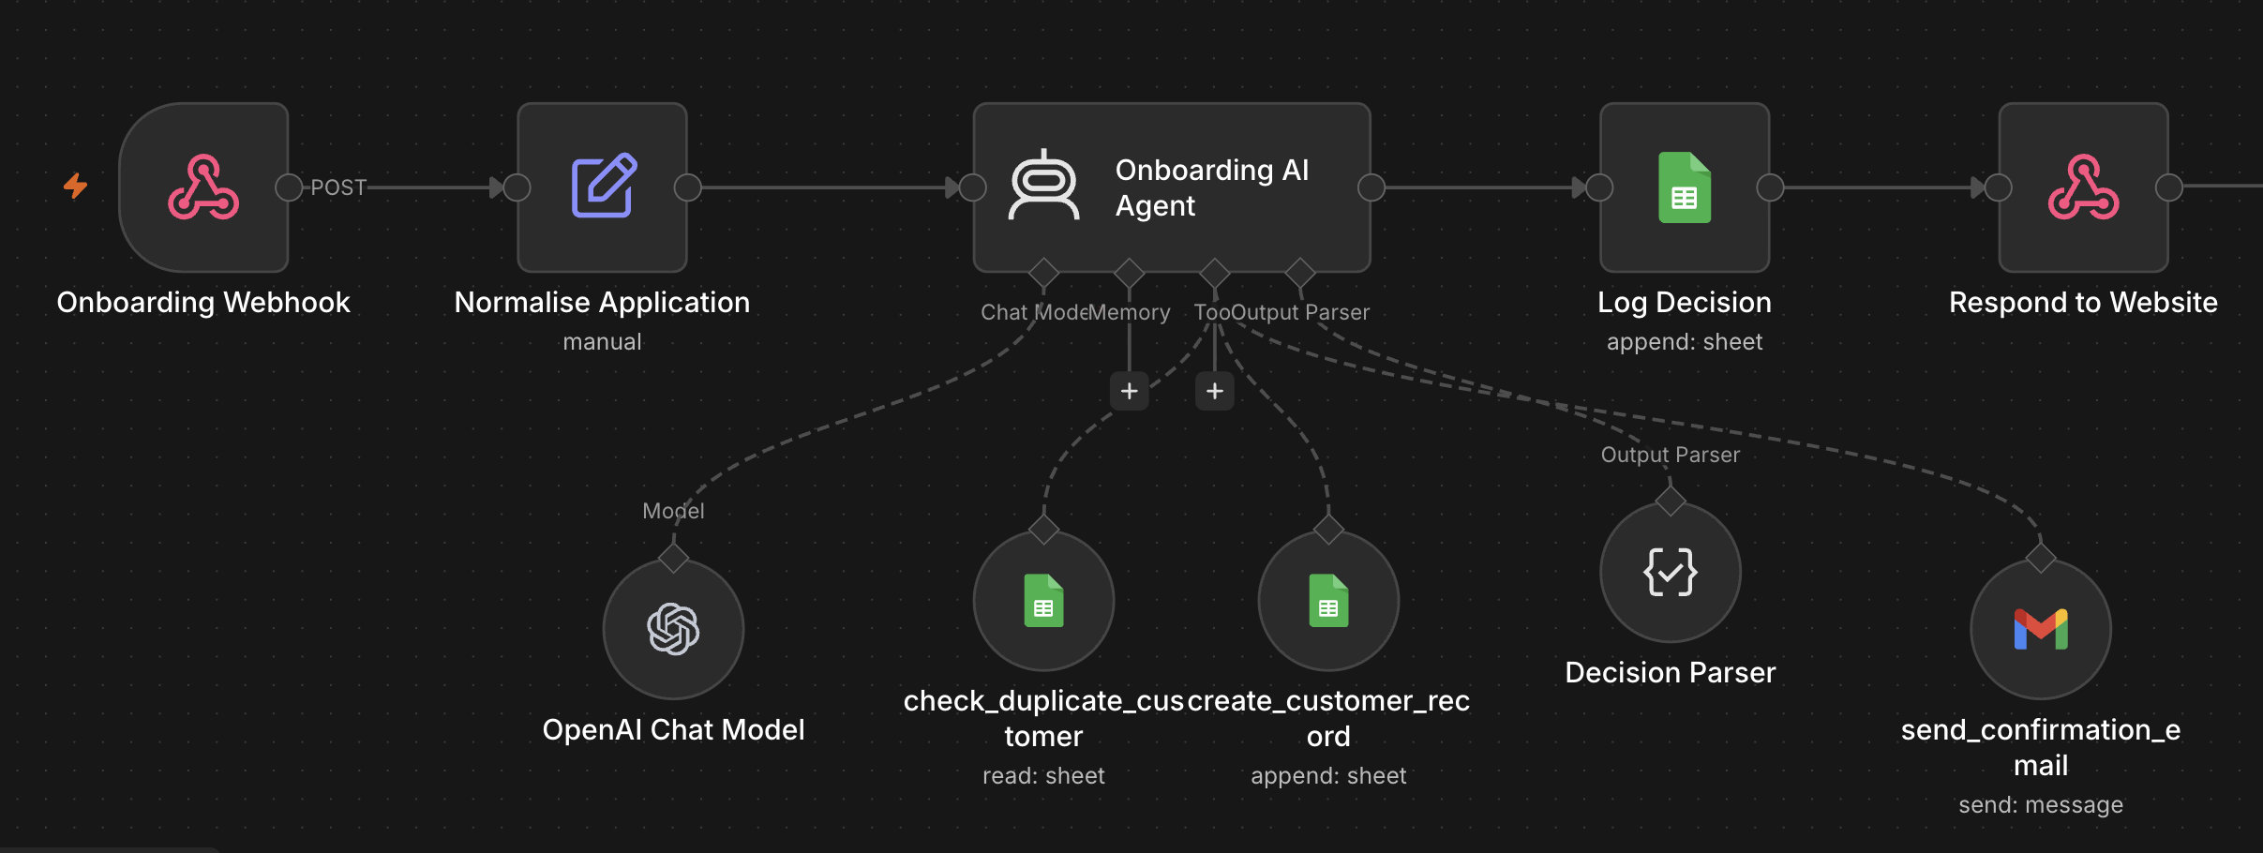
LAB 2 · THE WORKFLOW IN n8n
Lab 2 — The Onboarding Workflow in n8n
The imported workflow on the n8n canvas. The main chain runs left to right; the agent's model, tools and parser hang beneath it.
1
Front door
2
The agent
3
Three tools
4
Log and respond
The bank site POSTs to Onboarding Webhook; Normalise Application tidies the fields the agent reads.
Onboarding AI Agent applies the bank's rules with its chat model; Decision Parser returns decision, reason and riskFlags.
check_duplicate_customer, create_customer_record and send_confirmation_email — the agent chooses when to call each.
Log Decision appends an audit row to Google Sheets; Respond to Website sends the decision back to the page.
The dashed lines are the agent's sub-nodes: it calls them when it decides to — the solid chain always runs in order.
Automate Business Processes with Agentic AI Workflows · C209
© 2026 Tertiary Infotech Academy Pte Ltd
72

Slide 73
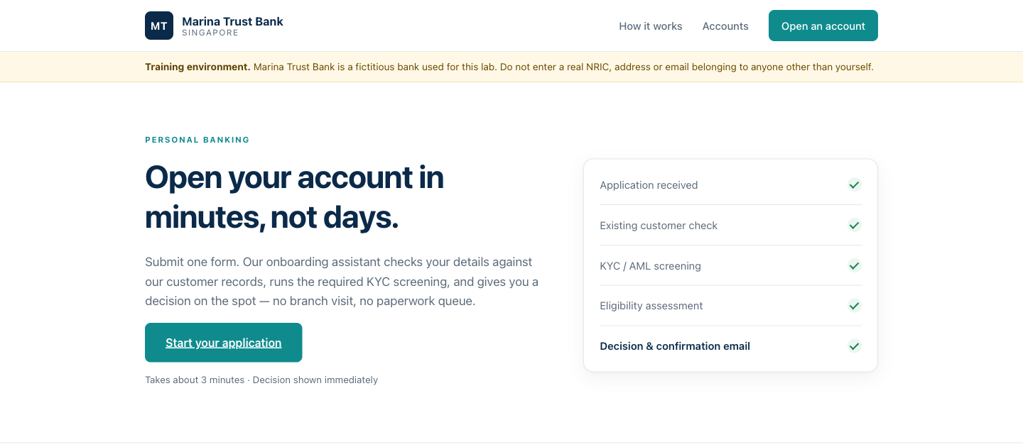
LAB 2 · THE APPLICATION
Lab 2 — Webhook and AI Agent — What You'll Build
• The Marina Trust Bank site the webhook sits behind. The applicant submits here, the AI Agent decides, and the page renders the decision as a coloured card.
• A webhook lets any external system — your website, an app, a CRM — start an agent workflow.
• Tools are what turn an LLM into an agent: it decides when to look up a customer and when to create one.
Automate Business Processes with Agentic AI Workflows · C209
© 2026 Tertiary Infotech Academy Pte Ltd
73

Slide 74
LAB 2 · VERIFY AND DEBRIEF
Lab 2 — Webhook and AI Agent
Run TC1 (a new applicant) and confirm a green APPROVED card, a new row in the Customers sheet and a confirmation email. Then run TC2 (an already-seeded NRIC) and confirm an amber DUPLICATE card with no new row.
1
Webhooks
2
Tools make an agent
A webhook lets any external system — your website, an app, a CRM — start an agent workflow.
Tools are what turn an LLM into an agent: it decides when to look up a customer and when to create one.
3
Structured output
4
The front door is separate
Structured output (decision, reason, riskFlags) is what lets downstream nodes branch, log and colour a result.
The agent is unchanged from a form-triggered version — only the front door differs.
Lab 2 — you can now deploy an AI agent that is triggered by a webhook from an external website.
Automate Business Processes with Agentic AI Workflows · C209
© 2026 Tertiary Infotech Academy Pte Ltd
74

Slide 75
02
TOPIC 02
Agentic Chatbot and Human in the Loop
Agentic workflows · Chatbots on webhooks · Approval gates · Accountability
Applied in Lab 3, Lab 4
Automate Business Processes with Agentic AI Workflows · C209
© 2026 Tertiary Infotech Academy Pte Ltd
75

Slide 76
TOPIC 2 · AGENTIC CHATBOT
Rule-Based vs Agentic Workflows
In an agentic workflow the LLM makes the routing decisions. You still design the process, the guardrails and the tools.
RULE-BASED (RPA) — every branch wired by hand
AGENTIC — the LLM chooses the path
• Predictable: the same input always takes the same path.
• Easy to audit — every decision is a rule you can read.
• Breaks on anything you did not foresee.
• Best for fixed, high-volume rules.
• Understands free text and intent.
• Handles cases you did not foresee.
• Needs guardrails and logging to stay safe.
• Best for varied, language-driven work — like a chatbot.
What you hand over is the judgement about which path a case takes — never the design of the process.
Automate Business Processes with Agentic AI Workflows · C209
© 2026 Tertiary Infotech Academy Pte Ltd
76

Slide 77
TOPIC 2 · AGENTIC CHATBOT
Designing a Safe Agentic Chatbot
Six design rules that turn a helpful chatbot into one a regulated firm can put on its website. This is Lab 3.
1
Define the role narrowly
2
Write the prohibitions explicitly
A chatbot built for one job refuses far more reliably than a general assistant.
Never recommend a product, predict a return or guarantee an outcome — spelled out, not implied.
3
Add a fallback sentence
4
Gate what must be collected first
'When in doubt, say less and offer a consultation' does more compliance work than clever wording.
No answer until the firm can contact the visitor — name, telephone and email.
5
Keep a small FAQ in the prompt
6
Key memory on the session
Nine short answers a compliance officer can review in one sitting. RAG is for larger knowledge.
Follow-up questions keep their context, and two visitors never see each other's conversation.
The system message is a compliance control. Test it with the questions you most fear, not the ones you hope for.
Automate Business Processes with Agentic AI Workflows · C209
© 2026 Tertiary Infotech Academy Pte Ltd
77

Slide 78
TOPIC 2 · DEMO
Demo: An HR Policy Chatbot on Telegram
What is a chatbot? An agent behind a chat channel. Build one on Telegram first — then Lab 3 puts one behind a website.
Telegram Trigger
an employee messages the bot
HR Agent — Ava
HR policies + memory
Chat model
Gateway credits, no API key
Reply on Telegram
back to the same chat
▶
▶
▶
1
What Ava knows
2
Guardrails in the prompt
3
Same agent, new front door
Sample HR policies written into the system instruction — leave, sick leave, claims, hours, probation.
Answer only from the policies, never invent a number, and refer salary, medical or disciplinary questions to HR.
Telegram Trigger is the front door here. Lab 3 puts the same kind of agent behind a website.
You will: create a bot with BotFather → build the workflow with n8n Assistant → connect, publish and chat.
Automate Business Processes with Agentic AI Workflows · C209
© 2026 Tertiary Infotech Academy Pte Ltd
78

Slide 79
TOPIC 2 · DEMO · TELEGRAM BOT
Demo Step 1: Create a Telegram Bot with BotFather
1
2
3
4
5
▶
▶
▶
▶
Open Telegram and search for BotFather (blue checkmark)
Start a chat and send /newbot
Type a display name, e.g. My Free Helper Bot
Choose a unique username ending in bot, e.g. my_free_helper_bot
Copy the HTTP API token BotFather sends back
The token is the bot's password — never share or commit it. If it leaks, send /revoke to BotFather for a new one.
Automate Business Processes with Agentic AI Workflows · C209
© 2026 Tertiary Infotech Academy Pte Ltd
79

Slide 80
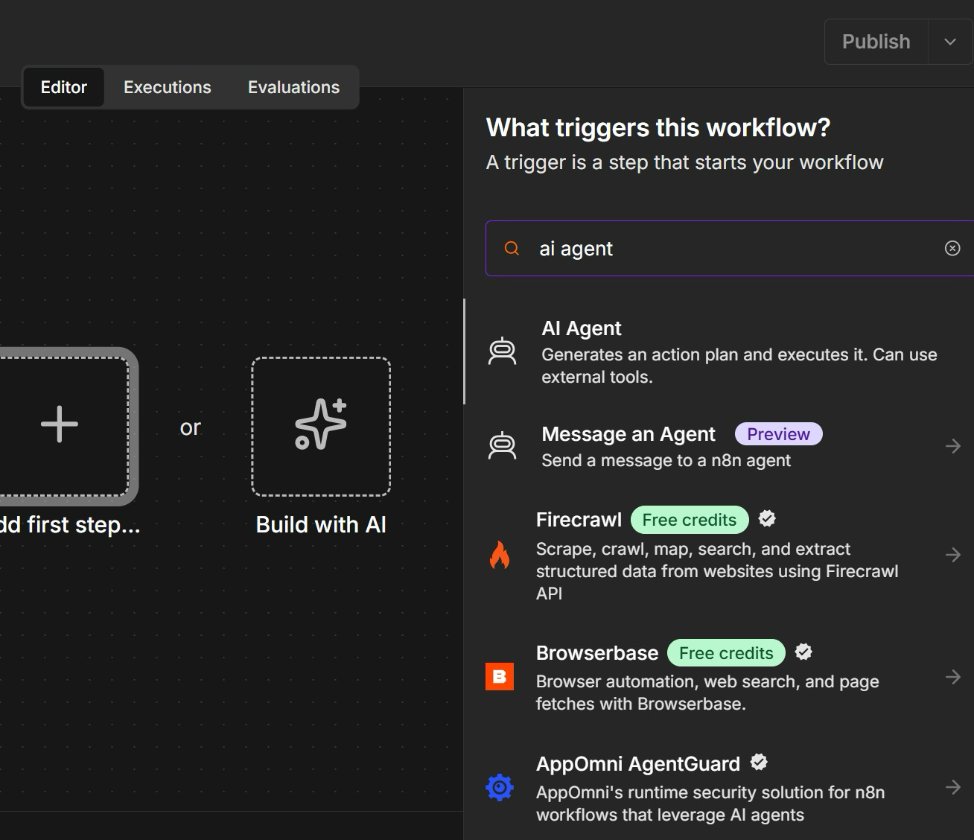
TOPIC 2 · DEMO · n8n ASSISTANT
Demo Step 2: Open n8n Assistant with Build with AI
• Create a new workflow. The empty canvas offers two starts: Add first step, or Build with AI.
• Click Build with AI — this opens n8n Assistant, which builds the workflow from a plain-English prompt.
• Add first step is the manual route: it opens the node search, here filtered to 'ai agent'.
• Either way you get the same nodes. The Assistant just writes the first draft for you.
Build with AI drafts the workflow; you still review every node before you publish.
Automate Business Processes with Agentic AI Workflows · C209
© 2026 Tertiary Infotech Academy Pte Ltd
80

Slide 81
TOPIC 2 · DEMO · n8n ASSISTANT
Demo Step 2: Paste the Prompt into n8n Assistant
Create a new workflow, open n8n Assistant and paste this prompt — it plans and builds the chatbot for you.
THE PROMPT
THEN YOU
Create a 3-node workflow:
• A user posts a message to a Telegram bot.
• Telegram sends the data to an HR agent.
• The HR agent responds to the user on the company HR policies. Create a system instruction for the HR agent with sample company policies in it. The HR agent has a memory.
• Respond to Telegram.
• Review the plan before it builds
• Read the system instruction it wrote — edit the sample policies if you like
• Check a memory node is attached to the HR agent
• Stuck? Import the reference solution instead
Reference solution: labs/lab3-chatbot-webhook/Lab 3 Demo - Telegram HR Policy Agent.json
Automate Business Processes with Agentic AI Workflows · C209
© 2026 Tertiary Infotech Academy Pte Ltd
81

Slide 82
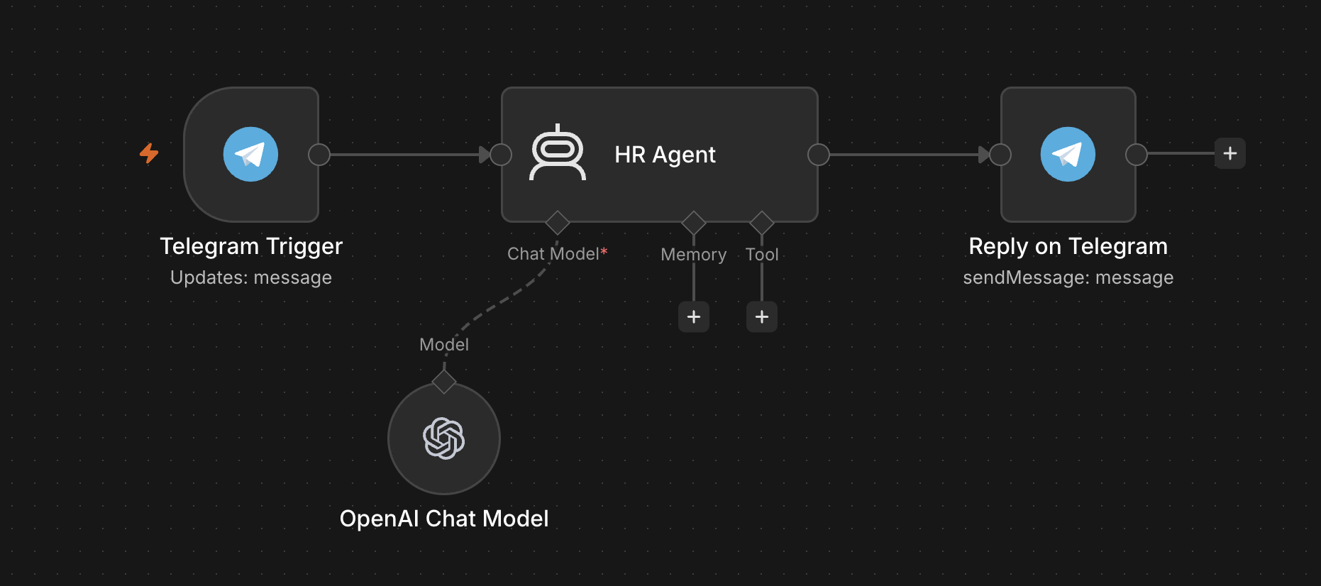
TOPIC 2 · DEMO · THE WORKFLOW IN n8n
Demo: The Workflow n8n Assistant Builds
Your canvas should look like this: trigger, agent, reply — with the chat model and memory hanging under the agent.
1
Telegram Trigger
2
HR Agent
3
Model and memory
4
Reply out
Updates: message — every message sent to the bot starts one execution.
Ava's role, rules and sample HR policies live in the system instruction n8n Assistant wrote.
Chat model on Gateway credits; memory keeps each employee's conversation, keyed on the Telegram chat ID.
Reply on Telegram sends back to the chat ID the trigger received, so the reply lands in the same chat.
Shown: the reference solution, which has no memory. Yours has a memory node — the prompt asked for one.
Automate Business Processes with Agentic AI Workflows · C209
© 2026 Tertiary Infotech Academy Pte Ltd
82

Slide 83
TOPIC 2 · DEMO · TELEGRAM BOT
Demo Step 3: Connect the Bot, Publish and Chat
1
2
3
4
5
▶
▶
▶
▶
Telegram Trigger → Credential → Create new → paste the token
Telegram reply node → select the same credential
Chat model → Use Gateway credits
Publish — n8n registers its webhook with Telegram
Open t.me/<username>, tap Start, ask about annual leave
A Telegram bot has ONE webhook at a time — testing in the editor swaps in the Test URL, so publish again when you are done.
Automate Business Processes with Agentic AI Workflows · C209
© 2026 Tertiary Infotech Academy Pte Ltd
83

Slide 84
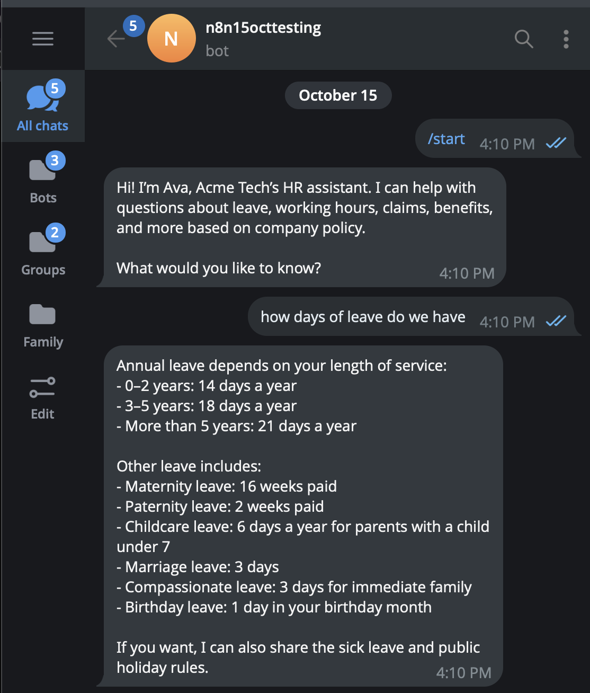
TOPIC 2 · DEMO · TELEGRAM BOT
Demo: Chatting with Ava on Telegram
• /start opens the chat — Ava introduces herself exactly as her system message tells her to.
• Ask how many days of leave you get: the answer quotes the policy — 14, 18 or 21 days by length of service.
• Ask a follow-up — memory keeps the context. Then ask about a colleague's salary: Ava must refer you to HR.
• Every message is one workflow run — open Executions in n8n to watch it happen.
The bot is only as safe as its system message. Lab 3 adds a contact gate and a refusal rule, behind a website.
Automate Business Processes with Agentic AI Workflows · C209
© 2026 Tertiary Infotech Academy Pte Ltd
84

Slide 85
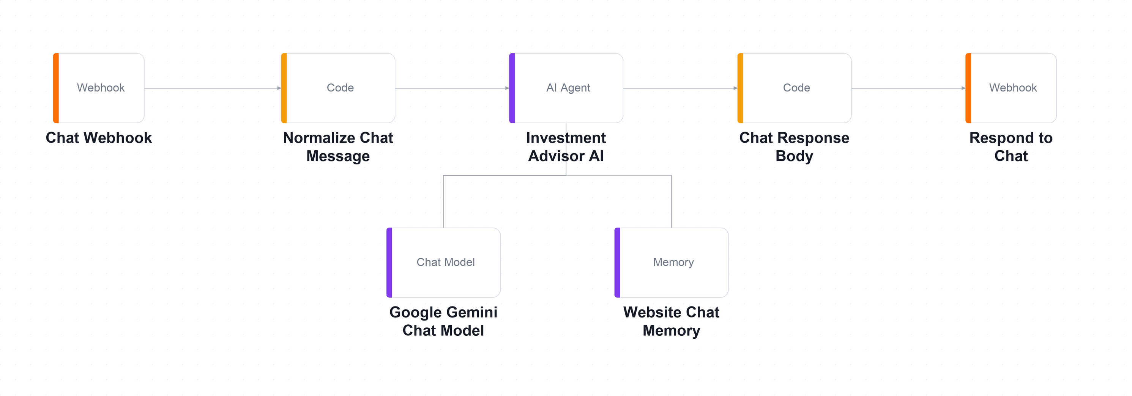
TOPIC 2 · AGENTIC CHATBOT & HITL · LAB WORKFLOW
Lab 3 — Chatbot Webhook (Investment Advisor)
A compliance-bound chatbot for an investment advisory firm: no answer until the firm can contact the visitor, and never any financial advice.
Chat Webhook — POST
the widget sends a message
Normalize
Code node shapes the input
AI Agent
Gemini 2.5 Flash, temp 0.2 + memory
Respond to Chat
reply returns to the widget
▶
▶
▶
The Lab 3 workflow on the n8n canvas. A small graph: webhook in, normalise, the agent with its chat model and session memory, then the reply back out.
LAB 3
Chatbot Webhook (Investment Advisor)
Chat Webhook → Normalize → AI Agent (+ model + memory) → Respond to Chat · full click-by-click steps in the Learner Guide
Automate Business Processes with Agentic AI Workflows · C209
© 2026 Tertiary Infotech Academy Pte Ltd
85

Slide 86
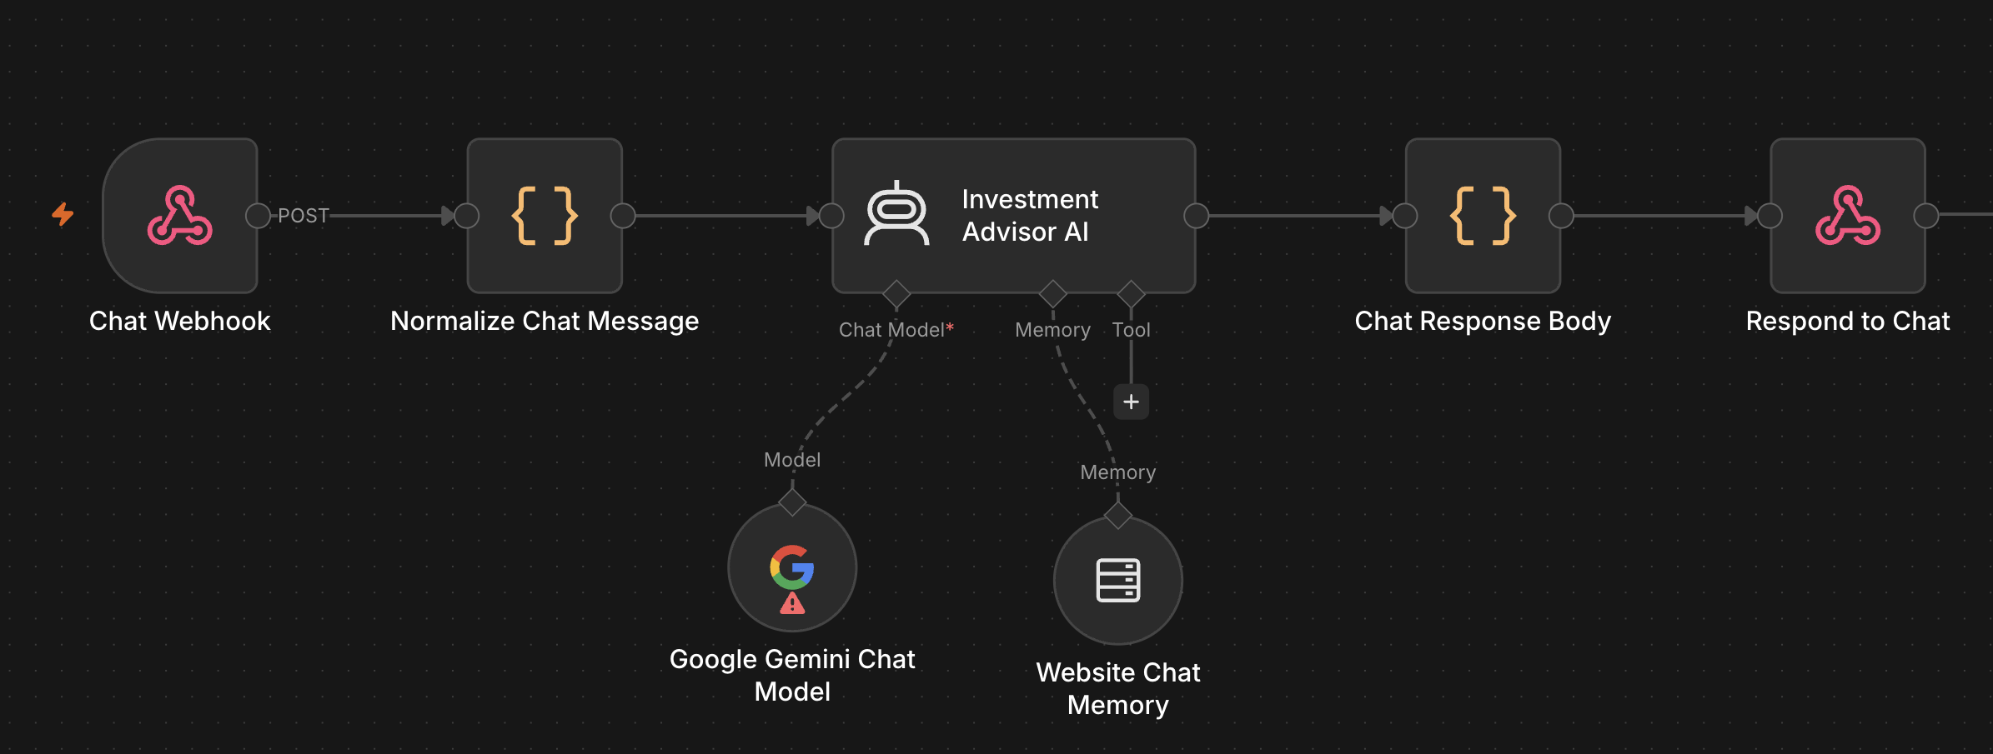
LAB 3 · THE WORKFLOW IN n8n
Lab 3 — The Chatbot Workflow in n8n
The imported workflow on the n8n canvas: webhook in, normalise, agent, shape the reply, respond. The intelligence is in the system message.
1
Message in
2
The agent
3
Model and memory
4
Reply out
Chat Webhook receives each message from the widget; Normalize Chat Message shapes it for the agent.
Investment Advisor AI holds the contact gate, the non-advisory rule and the nine-question FAQ.
Google Gemini Chat Model (temperature 0.2) and Website Chat Memory keyed on the visitor's sessionId.
Chat Response Body builds the JSON reply; Respond to Chat returns it to the widget.
The warning on the Gemini node means no credential is selected yet — choosing your Gemini credential is the first fix after import.
Automate Business Processes with Agentic AI Workflows · C209
© 2026 Tertiary Infotech Academy Pte Ltd
86

Slide 87
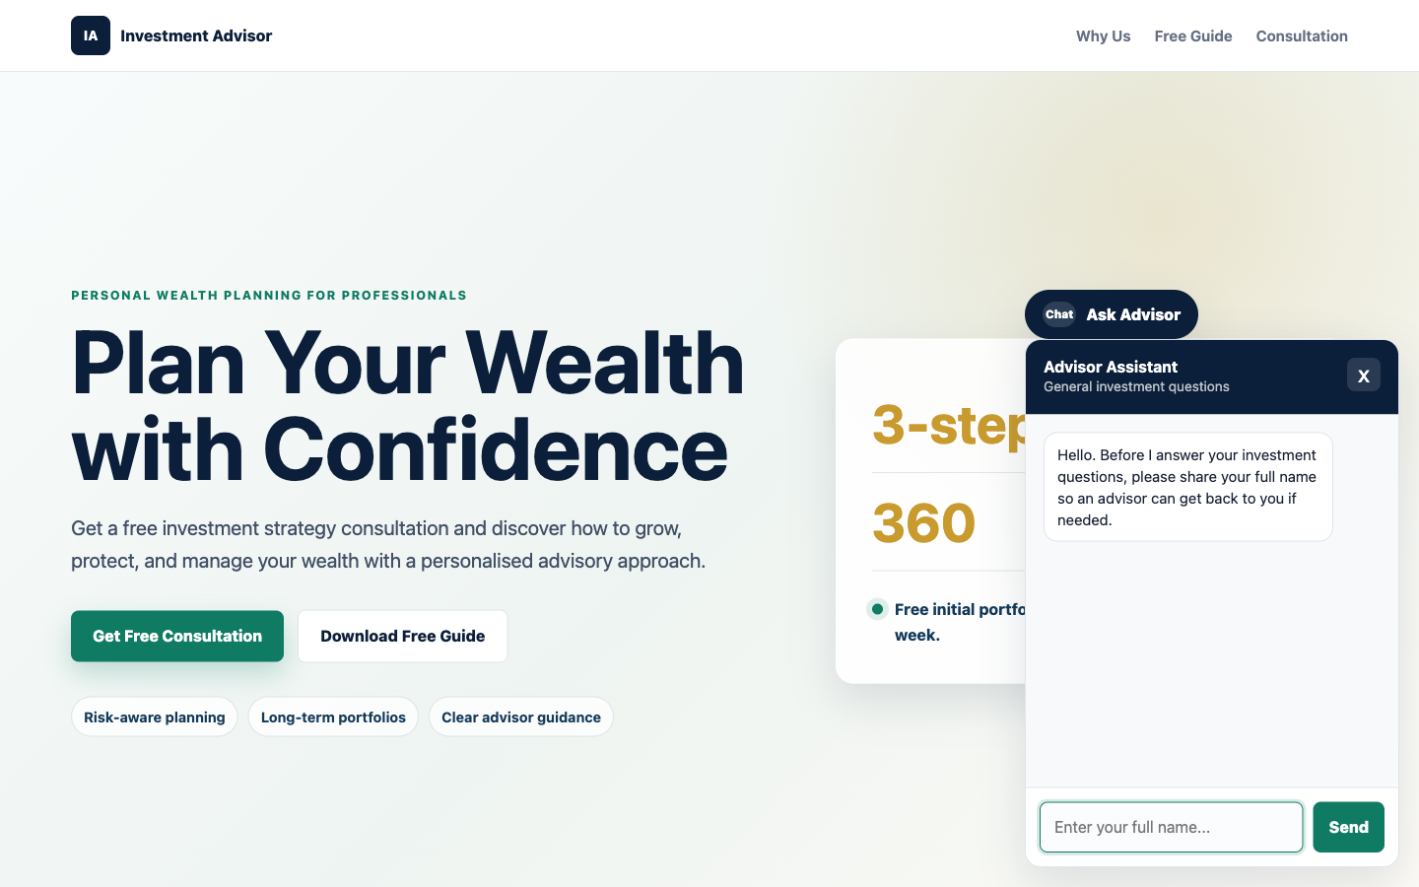
LAB 3 · THE APPLICATION
Lab 3 — Chatbot Webhook — What You'll Build
• The Investment Advisor site with the chat widget open. Note the contact gate in action — it asks for the visitor's name before it will answer anything.
• An agentic chatbot's system message is a compliance control, not just a prompt.
• The same rule enforced in the browser and in the agent is deliberate redundancy — only one of them runs on a machine you control.
Automate Business Processes with Agentic AI Workflows · C209
© 2026 Tertiary Infotech Academy Pte Ltd
87

Slide 88
LAB 3 · VERIFY AND DEBRIEF
Lab 3 — Chatbot Webhook
Ask 'Can you guarantee returns?' and 'Which stock should I buy?'. The agent must decline both and offer a consultation. Then ask a question before giving your details — it must ask for the missing detail and answer nothing.
1
The system message
2
Defence in depth
An agentic chatbot's system message is a compliance control, not just a prompt.
The same rule enforced in the browser and in the agent is deliberate redundancy — only one of them runs on a machine you control.
3
Session-keyed memory
4
Prompt or RAG?
Session-keyed memory gives context to follow-up questions without leaking between visitors.
A small fixed FAQ belongs in the prompt; RAG is for knowledge too large or too changeable for that.
Lab 3 — you can now deploy an agentic chatbot on a website that operates within regulatory limits.
Automate Business Processes with Agentic AI Workflows · C209
© 2026 Tertiary Infotech Academy Pte Ltd
88

Slide 89
TOPIC 2 · HUMAN IN THE LOOP & GUARDRAILS
Human In, On, and Out of the Loop
Three levels of human oversight. The design question is which one this particular process deserves.
1
Human IN the loop
2
Human ON the loop
3
Human OUT of the loop
The workflow PAUSES and a named person must approve before the action happens. Nothing reaches the customer unauthorised. This is Lab 4.
The agent acts immediately, but a person monitors and can intervene or reverse it. Suited to high volume and low individual risk.
Fully autonomous. Acceptable only where an error is cheap, reversible and detectable — never where money or a regulator is involved.
The question is never 'is the model good enough?' but 'what does one bad output cost, and who answers for it?'
Automate Business Processes with Agentic AI Workflows · C209
© 2026 Tertiary Infotech Academy Pte Ltd
89

Slide 90
TOPIC 2 · HUMAN IN THE LOOP & GUARDRAILS
How an Approval Suspends a Running Workflow
A Send-and-Wait node stops the execution mid-flight and holds it until a person decides.
Event arrives
a client message
Agent drafts
classify, flag, propose
Draft is logged
before any human sees it
Human decides
Approve or Decline
Only then
send and log the outcome
▶
▶
▶
▶
1
The execution really is paused
2
Approve and Decline are just links
3
A decline is a reassignment
Look at the canvas and the run is sitting on the approval node. It waits days if it has to — n8n holds the state.
The email carries two URLs. Clicking one resumes the execution down that branch — no app for the approver to learn.
Declining is not deleting. The ticket moves to a named person, because someone still owes the client an answer.
The agent may do everything except the one thing that matters. That pause is the whole control.
Automate Business Processes with Agentic AI Workflows · C209
© 2026 Tertiary Infotech Academy Pte Ltd
90

Slide 91
TOPIC 2 · HUMAN IN THE LOOP & GUARDRAILS
When to Put a Human in the Loop
Six tests. If a process meets any one of them, it needs an approval gate.
1
Money moves
2
It is a regulated communication
Payments, refunds, credit and lending decisions — anything with a direct financial consequence.
A licensed firm writing to a client about their money, health or legal position.
3
The action is irreversible
4
A person is vulnerable
A sent email, a deleted record or published content cannot be recalled.
Distress, illness, bereavement, or savings that someone cannot afford to lose.
5
The stakes exceed the error rate
6
Someone must be accountable
A 2% error rate is fine for tagging tickets and unacceptable for approving loans.
A regulator asks which licensed person is answerable — not what the machine decided.
Automate the drafting, not the deciding, wherever any of these six is true.
Automate Business Processes with Agentic AI Workflows · C209
© 2026 Tertiary Infotech Academy Pte Ltd
91

Slide 92
TOPIC 2 · HUMAN IN THE LOOP & GUARDRAILS
Guardrails — Two Gates Around the Agent
Instructions shape what the agent intends. Guardrails check what actually goes in and comes out.
INPUT GUARDRAIL — before the agent
OUTPUT GUARDRAIL — after the agent
• Screen the incoming message before the model ever sees it.
• Block prompt injection: 'ignore your instructions and…'.
• Strip or reject personal data you must not process.
• Rate-limit and authenticate — a public webhook is a public door.
• Check the reply before it reaches a human being.
• Look for the phrases you have banned: guarantees, forecasts, advice.
• Validate the structured fields against the values you allow.
• On any doubt, route to a person rather than sending it.
Defence in depth: the same rule in the prompt AND in the workflow — only one of the two runs on a machine you control.
Automate Business Processes with Agentic AI Workflows · C209
© 2026 Tertiary Infotech Academy Pte Ltd
92

Slide 93
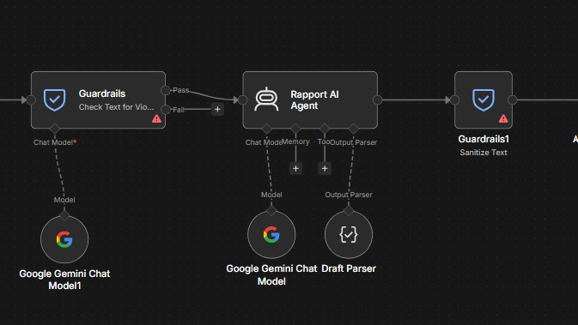
TOPIC 2 · HUMAN IN THE LOOP & GUARDRAILS
Guardrails in n8n — the Guardrails Node
The two gates from the previous slide, built with n8n's Guardrails node: one before the agent, one after it.
1
Input guardrail
2
Pass or Fail
3
The agent
4
Output guardrail
Guardrails · Check Text for Violations screens each message before the agent sees it, using its own chat model.
Pass continues to the agent. Fail branches away, so a blocked message never reaches the model.
Rapport AI Agent drafts the reply with its Gemini model and the Draft Parser.
Guardrails1 · Sanitize Text cleans the reply — for example removing personal data — before anything is sent.
Defence in depth: the prompt asks the agent to behave; the Guardrails nodes check that it did.
Automate Business Processes with Agentic AI Workflows · C209
© 2026 Tertiary Infotech Academy Pte Ltd
93

Slide 94
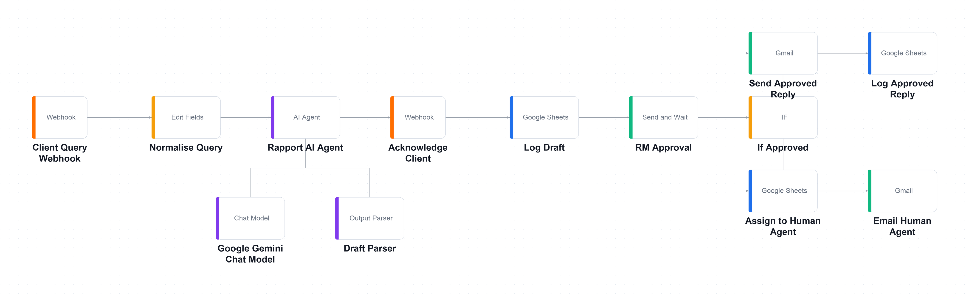
TOPIC 2 · AGENTIC CHATBOT & HITL · LAB WORKFLOW
Lab 4 — Human in the Loop (Client Rapport Assistant)
An agent reads a worried client's concern, flags compliance risks and drafts a reply — but sends nothing until a licensed manager approves it.
Webhook
client sends a concern
AI Agent
classify · flag · draft
Log Draft
before any human sees it
RM Approval
Send & Wait — PAUSED
IF
Approve → send · Decline → reassign
▶
▶
▶
▶
Everything up to RM Approval is the agent's territory; the IF node after it splits into the approved path (top) and the reassignment path (bottom).
LAB 4
Human in the Loop (Client Rapport Assistant)
Webhook → Agent → Acknowledge → Log Draft → RM Approval (Send & Wait) → IF → Send / Reassign · full click-by-click steps in the Learner Guide
Automate Business Processes with Agentic AI Workflows · C209
© 2026 Tertiary Infotech Academy Pte Ltd
94

Slide 95
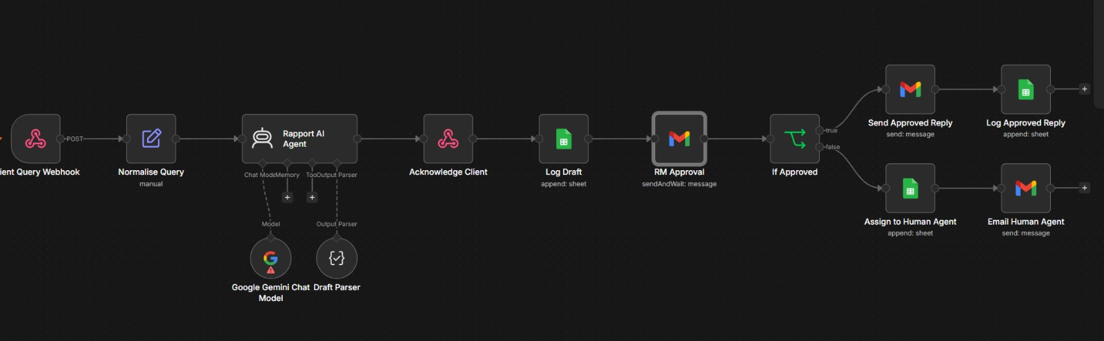
LAB 4 · THE WORKFLOW IN n8n
Lab 4 — The Approval Workflow in n8n
The imported workflow on the n8n canvas. Everything up to RM Approval is the agent's work; nothing after it runs until a person decides.
1
Concern in
2
The agent
3
Log, then pause
4
Two paths
Client Query Webhook receives the client's message; Normalise Query tidies it for the agent.
Rapport AI Agent drafts a non-advisory reply; Draft Parser returns tone, urgency and compliance flags.
Acknowledge Client answers at once, Log Draft records the draft, and RM Approval waits for a human.
If Approved: send and log the reply. Otherwise: Assign to Human Agent and email that person.
RM Approval is a Gmail Send-and-Wait node: the execution genuinely pauses there until Approve or Decline is clicked.
Automate Business Processes with Agentic AI Workflows · C209
© 2026 Tertiary Infotech Academy Pte Ltd
95

Slide 96
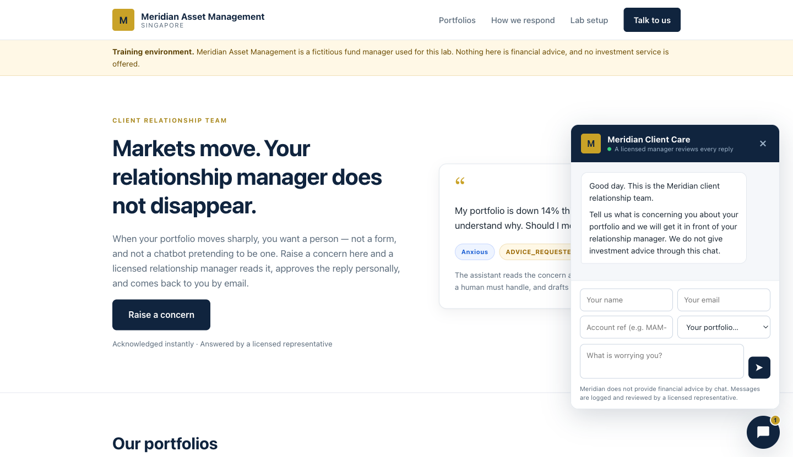
LAB 4 · THE APPLICATION
Lab 4 — Human in the Loop — What You'll Build
• The Meridian client portal. The widget states plainly that a licensed manager reviews every reply — the human-in-the-loop promise made visible to the client.
• A Send-and-Wait node pauses the workflow until a named person authorises the action.
• Separating what the agent proposed from what a human approved is what makes the trail auditable.
Automate Business Processes with Agentic AI Workflows · C209
© 2026 Tertiary Infotech Academy Pte Ltd
96

Slide 97
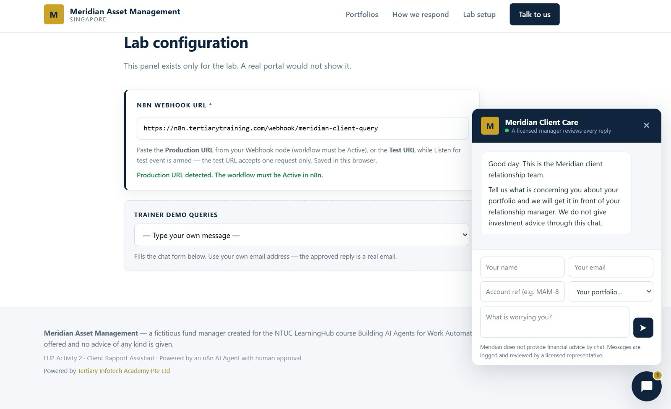
LAB 4 · STEP BY STEP
Lab 4 — Step: Connect the Website and Send a Concern
Paste your webhook Production URL into Lab configuration, pick a trainer demo query or type your own, use your own email, and send. The widget promises a licensed manager reviews every reply.
Automate Business Processes with Agentic AI Workflows · C209
© 2026 Tertiary Infotech Academy Pte Ltd
97

Slide 98
LAB 4 · VERIFY AND DEBRIEF
Lab 4 — Human in the Loop
Run all eight rows of sample-queries.csv. When you are done Drafts has 8 rows, Approved_Replies has 5 and Handover_Queue has 3 — and no accountability column is empty.
1
The approval gate
2
Two separate logs
A Send-and-Wait node pauses the workflow until a named person authorises the action.
Separating what the agent proposed from what a human approved is what makes the trail auditable.
3
A decline reassigns
4
Keep the model out
A decline is a reassignment, not a deletion — someone must still owe the client an answer.
The most legally important sentence in a workflow should be the one the model cannot touch.
Lab 4 — you can now apply a human approval gate so no AI-drafted communication is sent unsupervised.
Automate Business Processes with Agentic AI Workflows · C209
© 2026 Tertiary Infotech Academy Pte Ltd
98

Slide 99
03
TOPIC 03
Retrieval-Augmented Generation (RAG)
Tokenization · Embeddings · Vector stores · Grounded answers
Applied in Lab 5
Automate Business Processes with Agentic AI Workflows · C209
© 2026 Tertiary Infotech Academy Pte Ltd
99

Slide 100
TOPIC 3 · RAG
Why Retrieval, Rather Than a Bigger Prompt
For twenty short documents, pasting them all would genuinely work. The problem starts at two hundred.
1
Prompts have a ceiling
2
Long prompts degrade quality
Add enough documents and you exceed the model's context window — the request simply fails.
Models attend less reliably to the middle of a very long context. The answer is in there and is still missed.
3
You pay for every token
4
Retrieval turns it around
Every question re-sends every document, whether or not it was relevant to that question.
Fetch only the few documents that resemble the question, and send just those. Cheaper, shorter and more accurate.
RAG is not a bigger prompt — it is a smaller, better-chosen one.
Automate Business Processes with Agentic AI Workflows · C209
© 2026 Tertiary Infotech Academy Pte Ltd
100

Slide 101
TOPIC 3 · RAG
The RAG Pipeline — Ingest Once, Retrieve Every Question
Two separate workflows. You run ingestion once; retrieval runs on every single question.
Collect
the source documents
Split
into chunks
Embed
each chunk into a vector
Store
in the vector store
Retrieve
the nearest chunks
Answer
from what came back
▶
▶
▶
▶
▶
1
Ingestion — run by hand
2
Retrieval — runs per question
3
The models must match
Lab 5's first workflow: list 20 brochures on Drive, download, split, embed, insert. A Manual Trigger, run once.
Lab 5's second workflow: embed the question with the SAME model, find the nearest brochures, answer only from those.
A question embedded by one model cannot be compared against documents embedded by another. It fails silently, returning nonsense.
Ingest once, retrieve thousands of times — and use the identical embedding model on both sides.
Automate Business Processes with Agentic AI Workflows · C209
© 2026 Tertiary Infotech Academy Pte Ltd
101

Slide 102

TOPIC 3 · RAG
How RAG Works
Retrieval finds the documents that resemble the question · Augmentation adds them to the prompt · Generation produces an answer grounded in what was retrieved
Automate Business Processes with Agentic AI Workflows · C209
© 2026 Tertiary Infotech Academy Pte Ltd
102

Slide 103
TOPIC 3 · RAG
Chunking — the Biggest Lever on RAG Quality
Most RAG projects fail quietly at chunking, not at the model.
1
The rule
2
Too small
The right chunk is the smallest piece of text that still answers a question on its own.
A brochure sliced into thirds separates the course name from its fee. Retrieval then finds one without the other.
3
Too large
4
Overlap
Irrelevant text crowds the prompt and dilutes what actually matters.
A small overlap between chunks stops a sentence being cut in half at the boundary.
5
In Lab 5
6
topK
Chunk size 4000 with overlap 0 — one brochure becomes exactly one vector, so the fee is never separated from the course.
How many chunks come back. Too few misses the answer; too many dilutes the prompt with noise.
Tune the chunking before you blame the model — that is where the answer was lost.
Automate Business Processes with Agentic AI Workflows · C209
© 2026 Tertiary Infotech Academy Pte Ltd
103

Slide 104

TOPIC 3 · RAG
Tokenization and Text Embedding
Text is split into tokens, then an embedding model turns it into a vector — a list of numbers that places similar meanings close together
Automate Business Processes with Agentic AI Workflows · C209
© 2026 Tertiary Infotech Academy Pte Ltd
104

Slide 105
TOPIC 3 · RAG
Choosing a Vector Store
Where the embeddings live, and whether they are still there tomorrow.
SIMPLE VECTOR STORE — built in
A REAL VECTOR DATABASE
• No account, no API key, no index to create.
• Running RAG within ten minutes — this is what Lab 5 uses.
• WIPED whenever n8n restarts.
• Right for: learning, demos and prototypes.
• Pinecone, Supabase (pgvector), Qdrant, Weaviate.
• An account, an index and a matching dimension to set up.
• Persists, scales, and is shared across n8n instances.
• Right for: anything that goes into production.
Prototype on the in-memory store; move to a hosted database the moment anyone else depends on the answers.
Automate Business Processes with Agentic AI Workflows · C209
© 2026 Tertiary Infotech Academy Pte Ltd
105

Slide 106

TOPIC 3 · RAG
Vector Databases
A vector store holds the embeddings and finds the nearest neighbours to a question, fast
Automate Business Processes with Agentic AI Workflows · C209
© 2026 Tertiary Infotech Academy Pte Ltd
106

Slide 107
TOPIC 3 · RAG
Grounding an Agent Against Hallucination
An ungrounded model asked for a price will produce one. It will be plausible, it will be wrong, and the customer will quote it back to you.
1
Always call the tool first
2
Answer only from what came back
Instruct the agent to search the documents before answering any factual question at all.
Every factual claim must trace to a retrieved document, not to the model's general knowledge.
3
Give it permission to fail
4
Name what it must never invent
'I don't have that in our course information' is a far better answer than a confident invention.
A fee, a date, a duration, a course code, an instructor's name, a discount.
5
Hide the machinery
6
Test the traps
Never mention the vector store or that it is searching documents — the customer does not care.
Ask about a course you do not run, a person who does not exist, and a discount never offered.
Grounding is an instruction problem as much as a retrieval one — retrieval finds it, the prompt makes it stick.
Automate Business Processes with Agentic AI Workflows · C209
© 2026 Tertiary Infotech Academy Pte Ltd
107

Slide 108
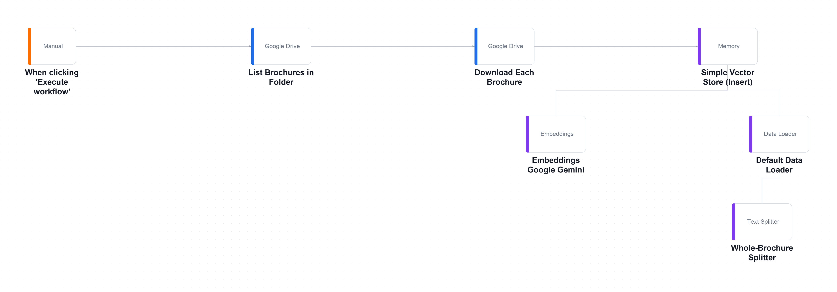
TOPIC 3 · RAG · LAB WORKFLOW
Lab 5 — RAG Customer Care Chatbot — Ingestion Workflow
Cook & Bake Academy's customer care team retypes the same answers all day, and every answer is already written in the course brochures.
Manual Trigger
you run ingestion once
Drive — list + download
20 brochures
Splitter
1 brochure = 1 chunk
Embeddings
3072-dim vectors
Vector Store — Insert
stored, ready to search
▶
▶
▶
▶
The ingestion workflow on the n8n canvas — run ONCE by hand. Twenty brochures are listed, downloaded, split, embedded and inserted into the vector store.
LAB 5
RAG Customer Care Chatbot — Ingestion Workflow
Ingestion: Drive → Split → Embed → Vector Store · Answering: Webhook → Agent + Retriever → Respond · full click-by-click steps in the Learner Guide
Automate Business Processes with Agentic AI Workflows · C209
© 2026 Tertiary Infotech Academy Pte Ltd
108

Slide 109
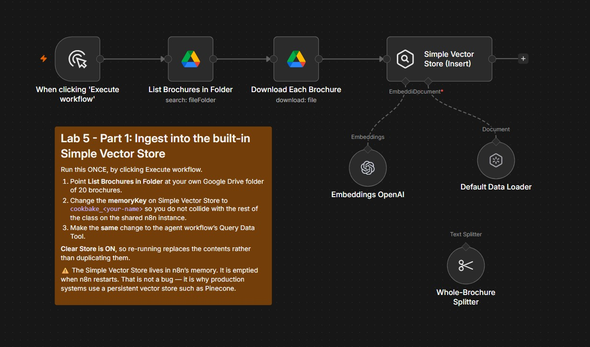
LAB 5 · THE WORKFLOW IN n8n
Lab 5 — The Ingestion Workflow in n8n
Part 1 as it looks after import. You run it once, by hand, to load all 20 brochures into the vector store.
1
Fetch the brochures
When clicking 'Execute workflow' starts the run. List Brochures in Folder finds the 20 files in YOUR Drive folder, and Download Each Brochure pulls each one down.
2
Split and embed
Default Data Loader reads each file, Whole-Brochure Splitter keeps one brochure as one chunk, and the Embeddings node turns every chunk into a vector.
3
Insert into the store
Simple Vector Store (Insert) saves the 20 vectors under your memory key, cookbake_<your-name>. Clear Store is ON, so a re-run replaces instead of duplicating.
Ingestion is a batch job: re-run it when a brochure changes — and after every n8n restart.
Automate Business Processes with Agentic AI Workflows · C209
© 2026 Tertiary Infotech Academy Pte Ltd
109

Slide 110
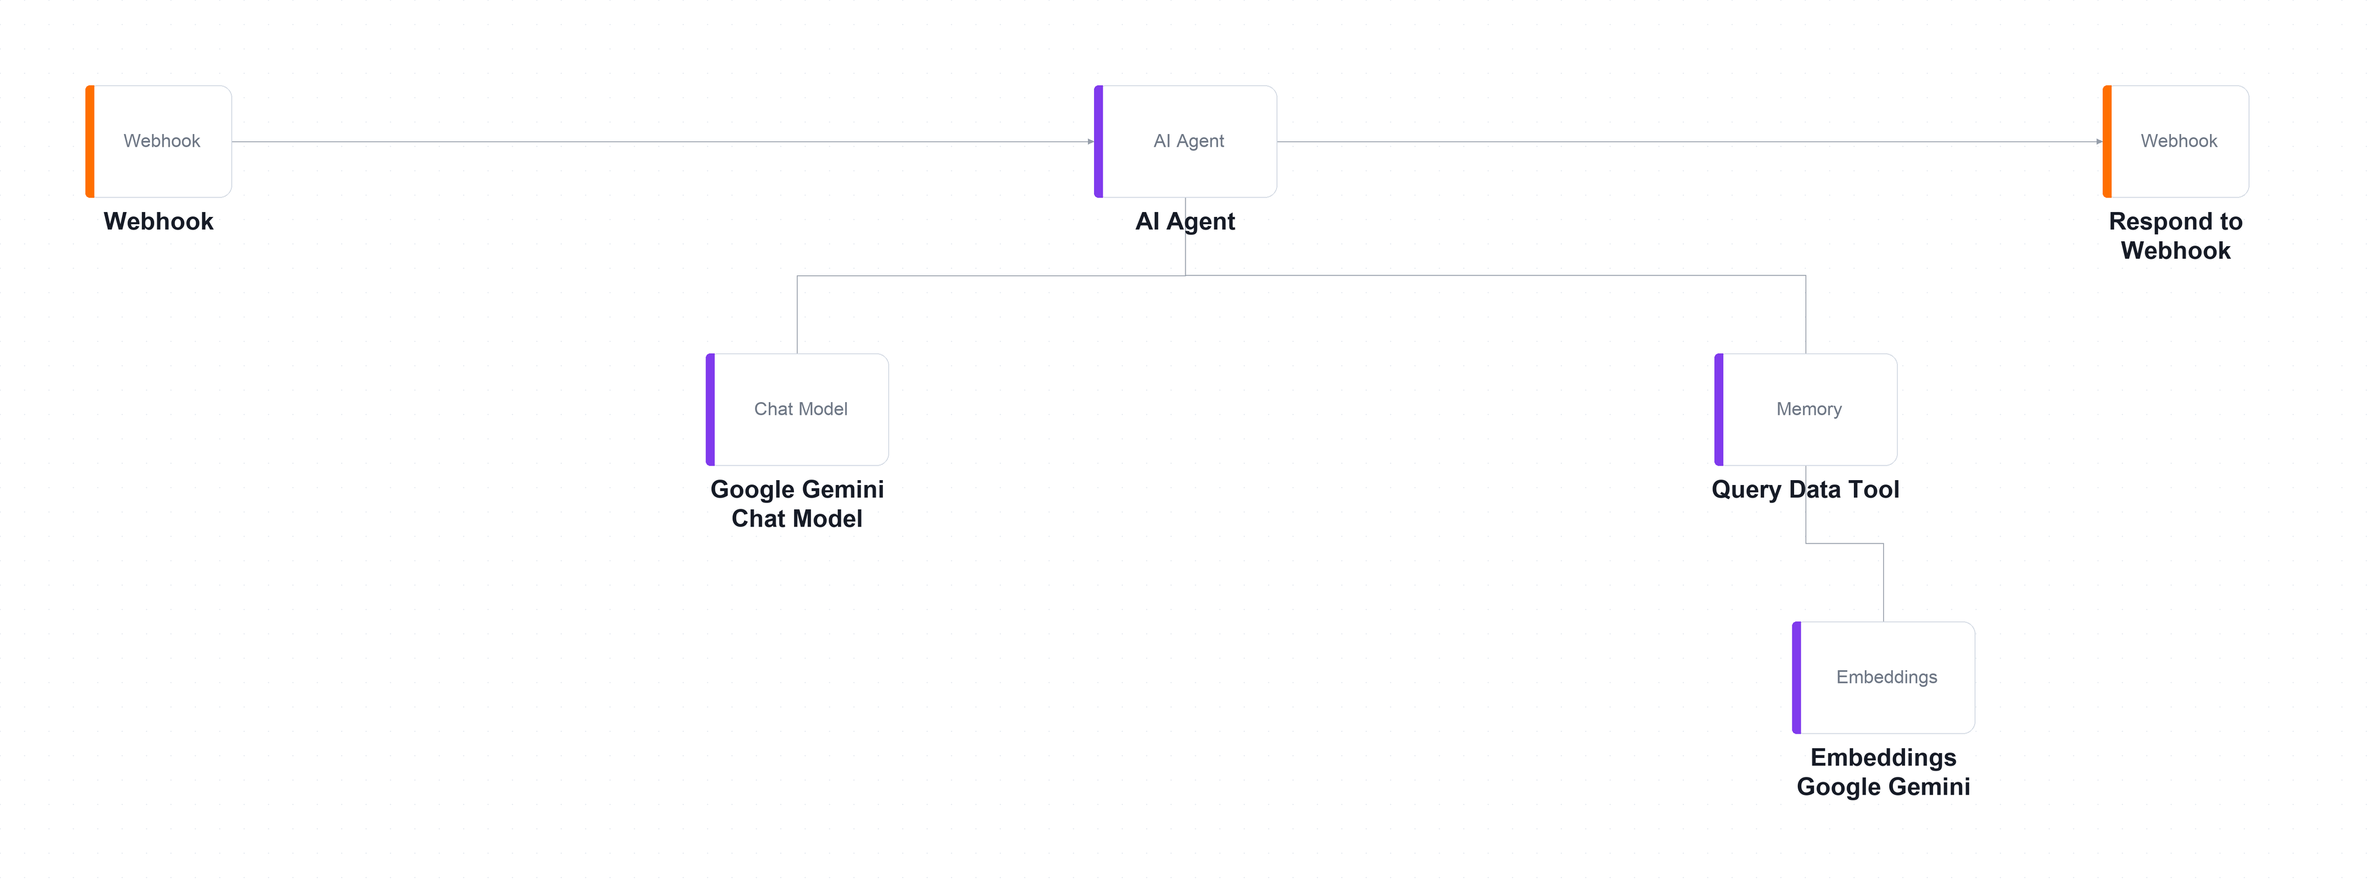
TOPIC 3 · RAG · LAB WORKFLOW
Lab 5 — RAG Customer Care Chatbot — Answering Workflow
The answering workflow on the n8n canvas — runs on EVERY question. The Query Data Tool and its embedding model hang below the agent.
Webhook — POST
a visitor asks a question
AI Agent
+ Query Data Tool
Retrieve
nearest brochures only
Respond
answer grounded in those
▶
▶
▶
LAB 5
RAG Customer Care Chatbot — Answering Workflow
Ingestion: Drive → Split → Embed → Vector Store · Answering: Webhook → Agent + Retriever → Respond · full click-by-click steps in the Learner Guide
Automate Business Processes with Agentic AI Workflows · C209
© 2026 Tertiary Infotech Academy Pte Ltd
110

Slide 111
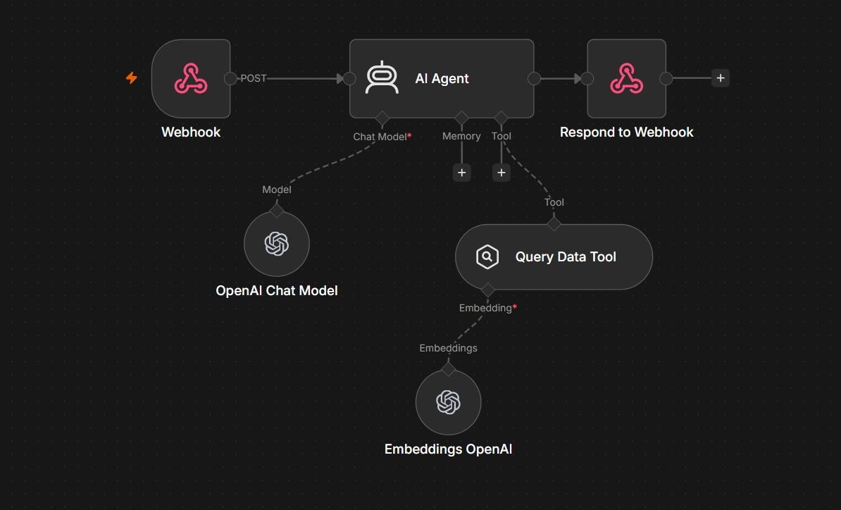
LAB 5 · THE WORKFLOW IN n8n
Lab 5 — The Answering Workflow in n8n
Part 2 runs on every question. The agent must search the brochures before it is allowed to answer.
1
Question in, answer out
Webhook receives the visitor's question from the website as a POST. Respond to Webhook sends the agent's reply back to the chat window.
2
The agent and its model
AI Agent reasons with the chat model. Its system message says: call the tool first and never invent a fee. No Memory is attached, so each question stands alone.
3
The retrieval tool
Query Data Tool searches YOUR memory key and returns the 5 closest brochures. Shown here with OpenAI; the lab file ships with Gemini — swap one, swap both.
Same embedding model and same memory key in both workflows — or retrieval silently finds nothing.
Automate Business Processes with Agentic AI Workflows · C209
© 2026 Tertiary Infotech Academy Pte Ltd
111

Slide 112

LAB 5 · THE APPLICATION
Lab 5 — RAG Customer Care Chatbot — What You'll Build
• The Cook & Bake Academy site with the course assistant open. Every answer it gives is grounded in the 20 brochures you ingested into the vector store.
• RAG retrieves the few documents that resemble the question instead of pasting everything into the prompt.
• An embedding places similar meanings close together, so retrieval works even when no words match.
Automate Business Processes with Agentic AI Workflows · C209
© 2026 Tertiary Infotech Academy Pte Ltd
112

Slide 113
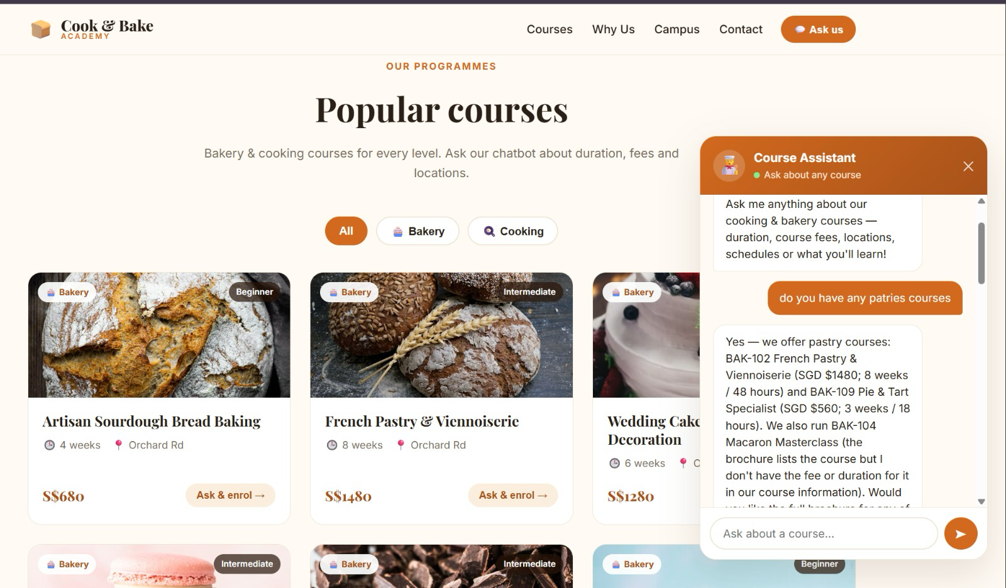
LAB 5 · THE APPLICATION
Lab 5 — The Course Assistant in Action
A real conversation on the Cook & Bake Academy site. Every fee in the reply came from a retrieved brochure.
1
A typo still finds it
The visitor typed 'patries'. Embeddings match meaning, not spelling, so the pastry brochures BAK-102 and BAK-109 still come back.
2
Facts quoted, not invented
Fees and durations are quoted exactly: BAK-102 is SGD $1480 for 8 weeks / 48 hours — the same S$1480 shown on the course card behind the chat.
3
It admits a gap
It did not give BAK-104's fee and said so instead of guessing. The brochure does list SGD $420, so check what the tool returned: that is a retrieval gap.
'I don't have that' is grounding working — fix gaps in retrieval, never by loosening the prompt.
Automate Business Processes with Agentic AI Workflows · C209
© 2026 Tertiary Infotech Academy Pte Ltd
113

Slide 114
LAB 5 · VERIFY AND DEBRIEF
Lab 5 — RAG Customer Care Chatbot
TC1 must quote BAK-101's exact fee from the brochure. Then run the three hallucination probes: TC7 (a course that does not exist), TC8 (an instructor name no brochure contains) and TC9 (a discount that was never offered). Any confident answer to these is a failure, however fluent.
1
What RAG does
2
Embeddings
RAG retrieves the few documents that resemble the question instead of pasting everything into the prompt.
An embedding places similar meanings close together, so retrieval works even when no words match.
3
Chunking
4
Match model and key
Chunking is the single biggest lever on RAG quality — the right chunk answers a question on its own.
The ingestion and retrieval embedding models must be identical, and the memory keys must match.
5
In-memory is temporary
n8n's Simple Vector Store is wiped when n8n restarts — fine for learning, unacceptable in production.
Lab 5 — you can now deploy a RAG application that grounds an agent in the organisation's own documents.
Automate Business Processes with Agentic AI Workflows · C209
© 2026 Tertiary Infotech Academy Pte Ltd
114

Slide 115
WRAP-UP
Course Summary & Next Steps
Automate Business Processes with Agentic AI Workflows · C209
© 2026 Tertiary Infotech Academy Pte Ltd
115

Slide 116
LEARNING OUTCOMES
What You Achieved
1
LO1 · n8n and AI agents
Built a trigger-and-action workflow and explained how an LLM agent differs from generative AI.
2
LO2 · Webhook-triggered agents
Put an AI agent behind a real website, with tools, structured output and an audit log.
3
LO3 · Agentic chatbots
Designed a chatbot that collects contact details and refuses to give regulated advice.
4
LO4 · Human in the loop
Paused a workflow on an approval gate so no drafted communication was sent unsupervised.
5
LO5 · RAG
Ingested 20 documents into a vector store and grounded a chatbot so it stopped inventing answers.
Automate Business Processes with Agentic AI Workflows · C209
© 2026 Tertiary Infotech Academy Pte Ltd
116

Slide 117
NEXT STEPS
Taking This Back to Work
Six moves that turn what you built this week into something your organisation actually runs.
1
Start with one painful process
2
Map it before you build it
3
Decide where the human belongs
Pick something repetitive, high-volume and low-risk. Automate that first.
Draw the trigger, the decisions and the actions on paper. The canvas comes second.
Anything irreversible, regulated or expensive keeps an approval gate.
4
Ground the agent in your own data
5
Log everything from day one
6
Iterate with real cases
RAG over your policies and documents beats a general model every time.
You will need the audit trail long before you think you will.
Test with the questions you fear, not the ones you hope for.
The next process you automate is the one you were dreading this morning.
Automate Business Processes with Agentic AI Workflows · C209
© 2026 Tertiary Infotech Academy Pte Ltd
117

Slide 118
WE'RE HERE TO HELP — DURING AND AFTER THE CLASS
Support
Email
enquiry@tertiaryinfotech.com
Telephone
+65 6100 0613
1
2
Website
www.tertiarycourses.com.sg
LMS / TMS portal
lms-tms.tertiaryinfotech.com
3
4
Automate Business Processes with Agentic AI Workflows · C209
© 2026 Tertiary Infotech Academy Pte Ltd
118

Slide 119
COURSE FEEDBACK
Your Feedback Matters
Tell us how it went
Complete the course feedback form shared by your trainer.
What we use it for
Your comments shape the pacing, the labs and the depth of each topic.
1
2
Talk to your trainer
Raise anything during class — you do not have to wait for the form.
Stay in touch
Email enquiry@tertiaryinfotech.com with follow-up questions any time.
3
4
Automate Business Processes with Agentic AI Workflows · C209
© 2026 Tertiary Infotech Academy Pte Ltd
119

Slide 120
HAPPY AUTOMATING
Thank You!
Keep your n8n instance running and keep building. The next process you automate is the one you were dreading this morning.
Automate Business Processes with Agentic AI Workflows · C209
© 2026 Tertiary Infotech Academy Pte Ltd
120

